Slide 1
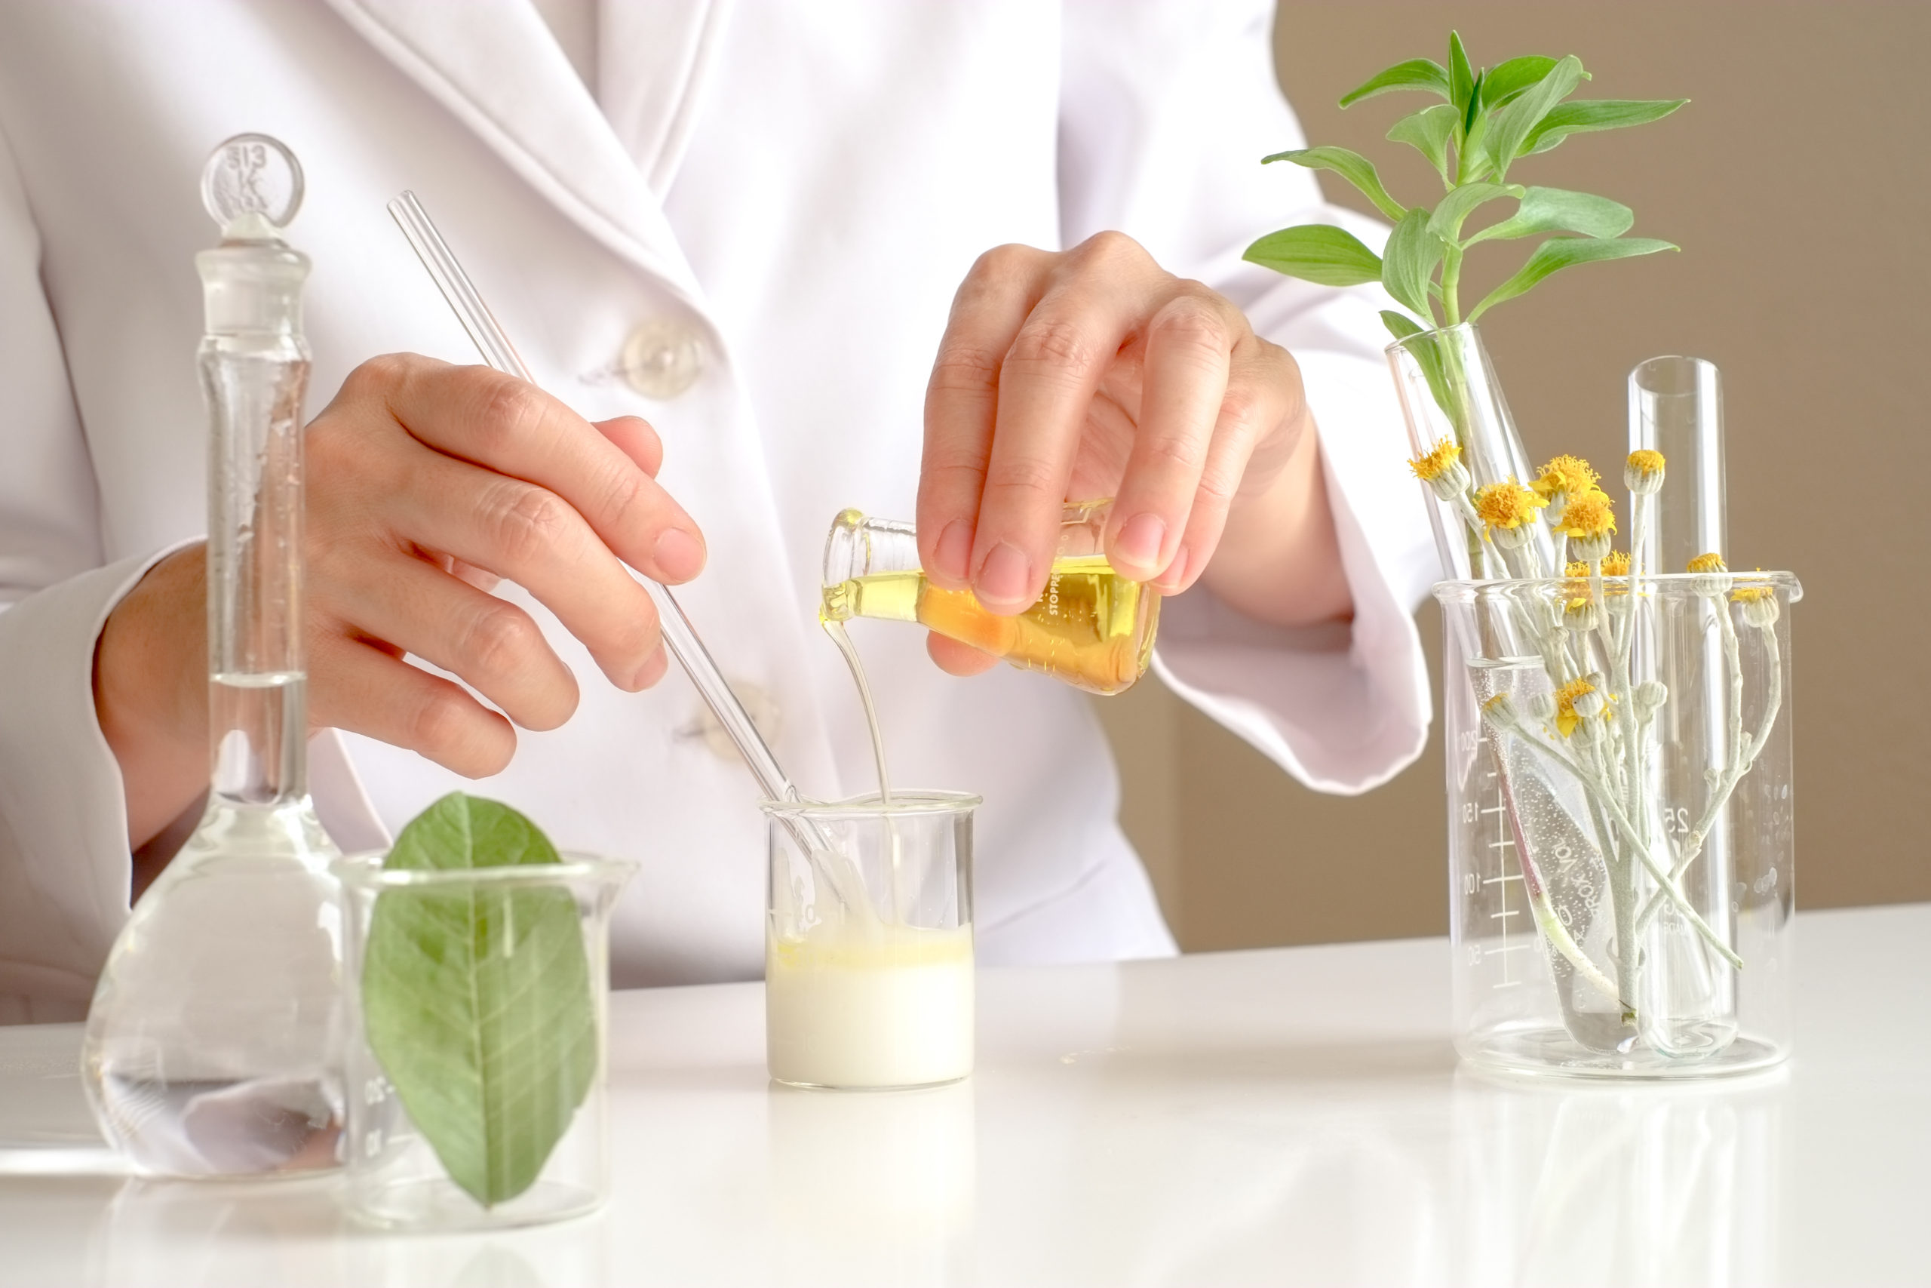
Plant stem cells in cosmetics
By: Fateme Faryadras

Slide 2
contents
Introduction
Plant stem cells
Propagation of plant stem cells in culture
Plant stem cells extracts
Protecting human stem cells
Reversing signs of senescence in fbroblast cells
Anti‑wrinkle effect
Marketed products
conclusion

Slide 3
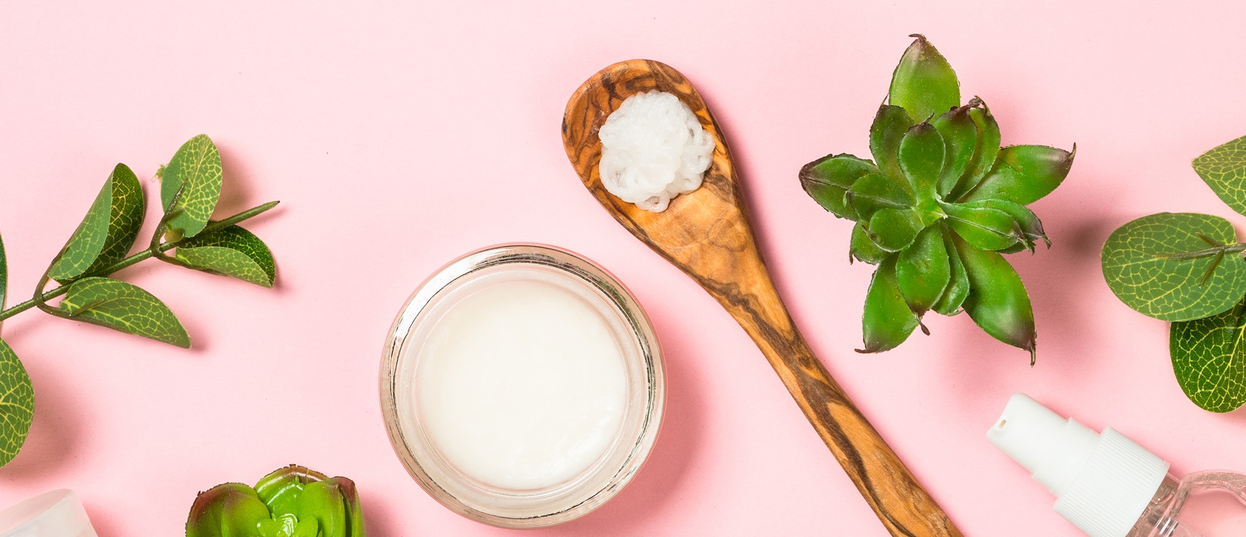
introduction
1
Stem cells are becoming increasingly popular in public lexicon owing to their prospective applications in the biomedical and therapeutic domains.
2
applications of plant stem cells:
Anti‑wrinkle
Protecting human stem cells
skin whitening
de-tanning
Moisturizing
Cleansing
Anti-aging

Slide 4
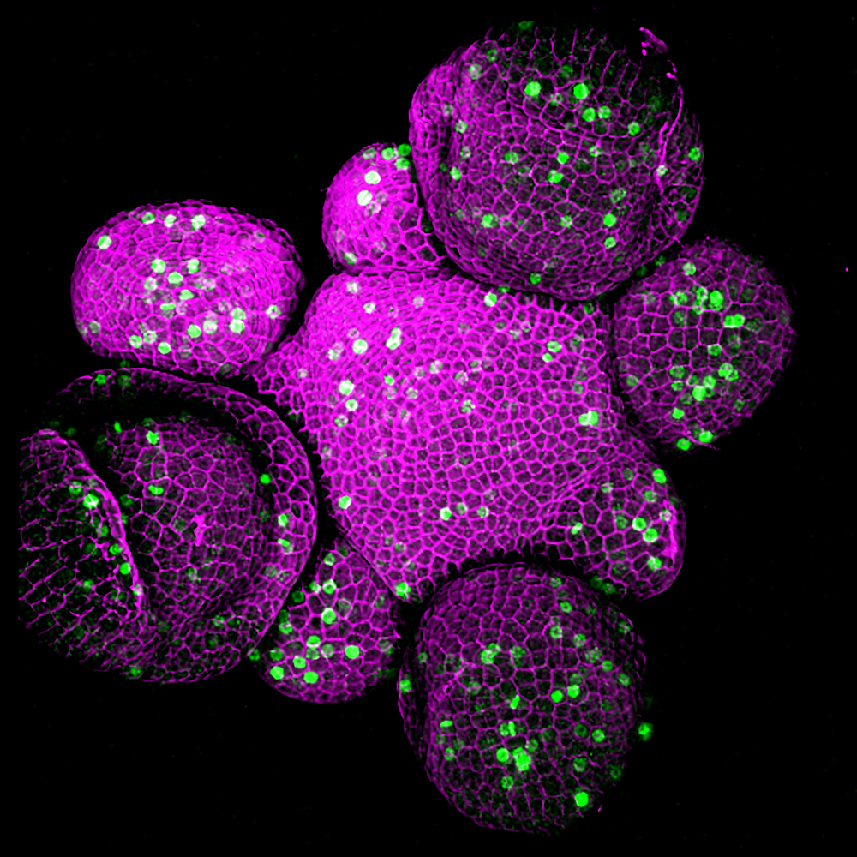
Plant stem cells
Plant stem cells are innately undiferentiated cells present in the plant’s meristematic tissues.
01
characteristic features
02
sources
03
type

Slide 5
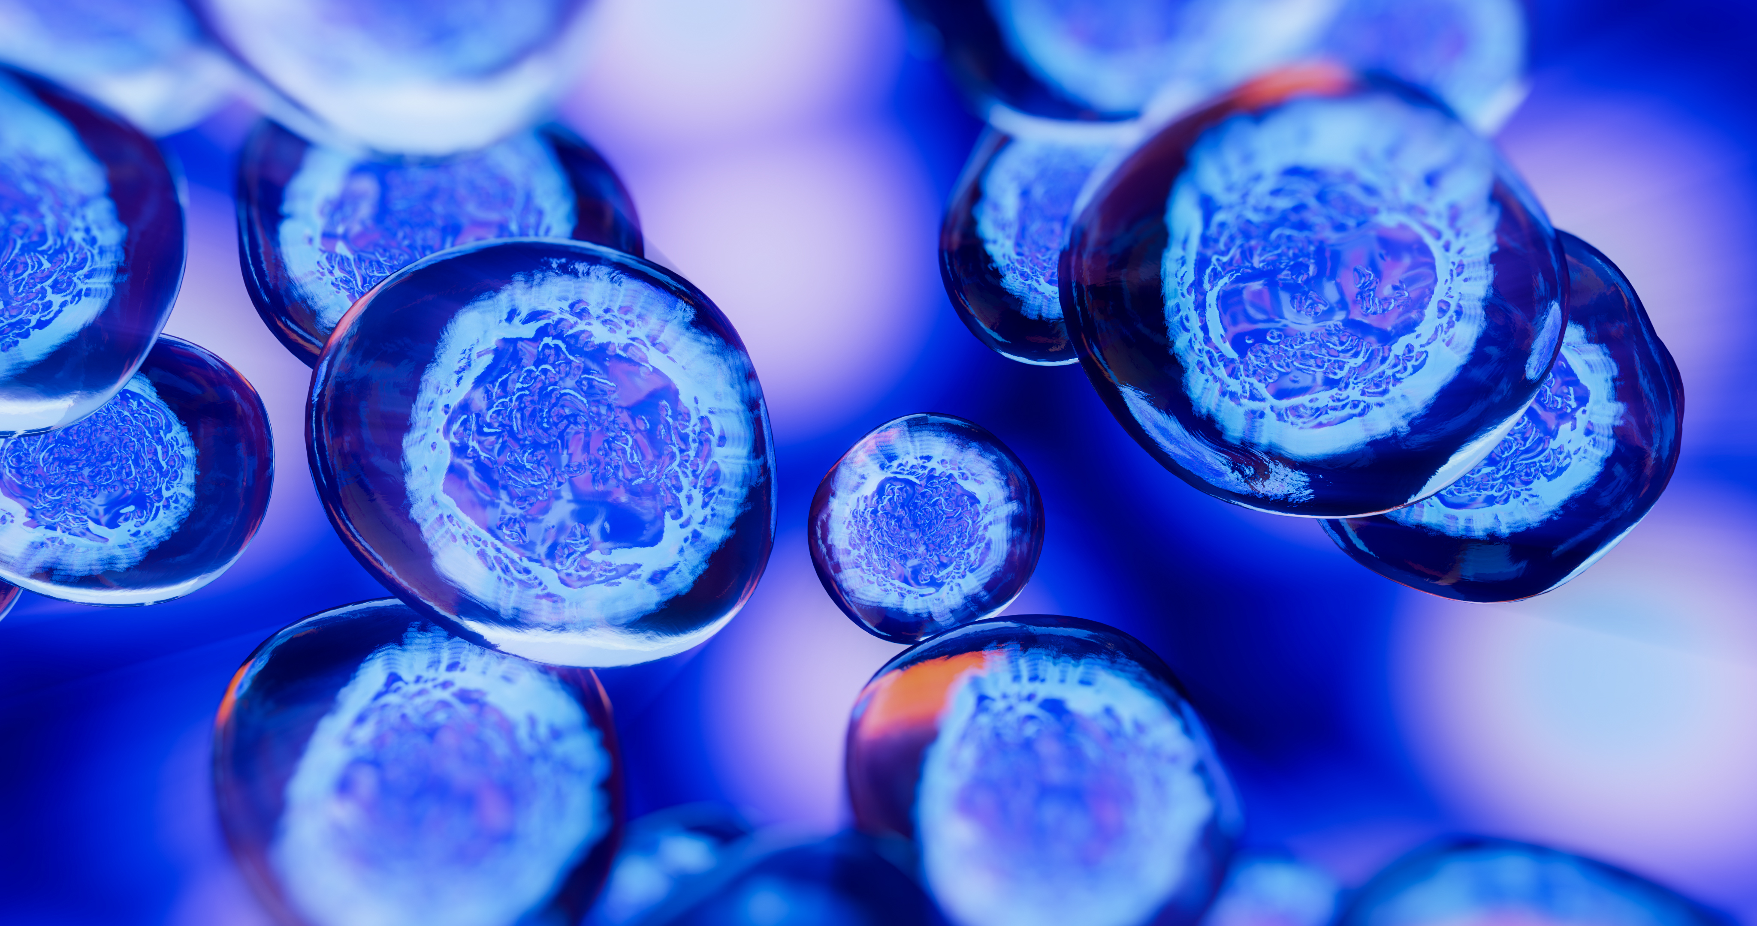

Plant stem cells vs animal stem cells
In mammals, the biggest drawback of stem cells is that specialized cells are unable to return to their original undiferentiated state. This limitation is overcome in case of plant stem cells which are capable of reverting to their original state without any external manipulation. Plants undertake a natural reprogramming process in order to replenish their stem cells.

Slide 6
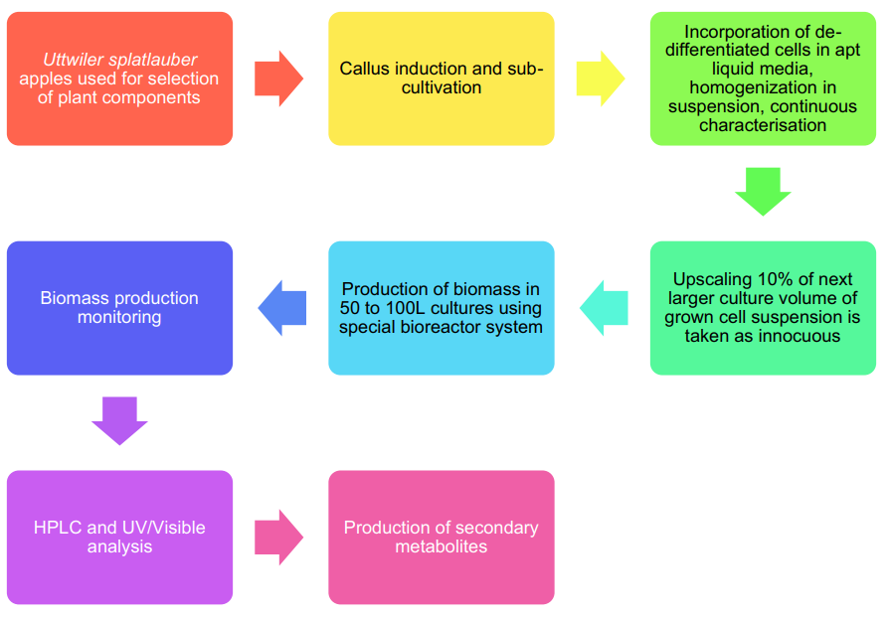

Propagation of plant stem cells in culture

Slide 7
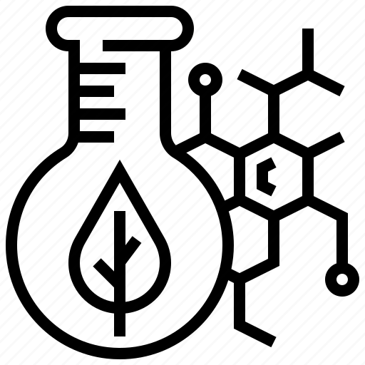
Plant stem cells extracts
species
aplications
gardenia (Gardenia jasminoides)
Prolongation of fibroblasts life
Increased epidermis flexibility
Regulation of cell division
Reconstruction of damaged epidermis
Activation of cell DNA repair
Protection against UV radiation
Echinacea (Echinacea purpurea)
lilac (Syringa vulgaris)
orange (Citrus sinensis)

Slide 8
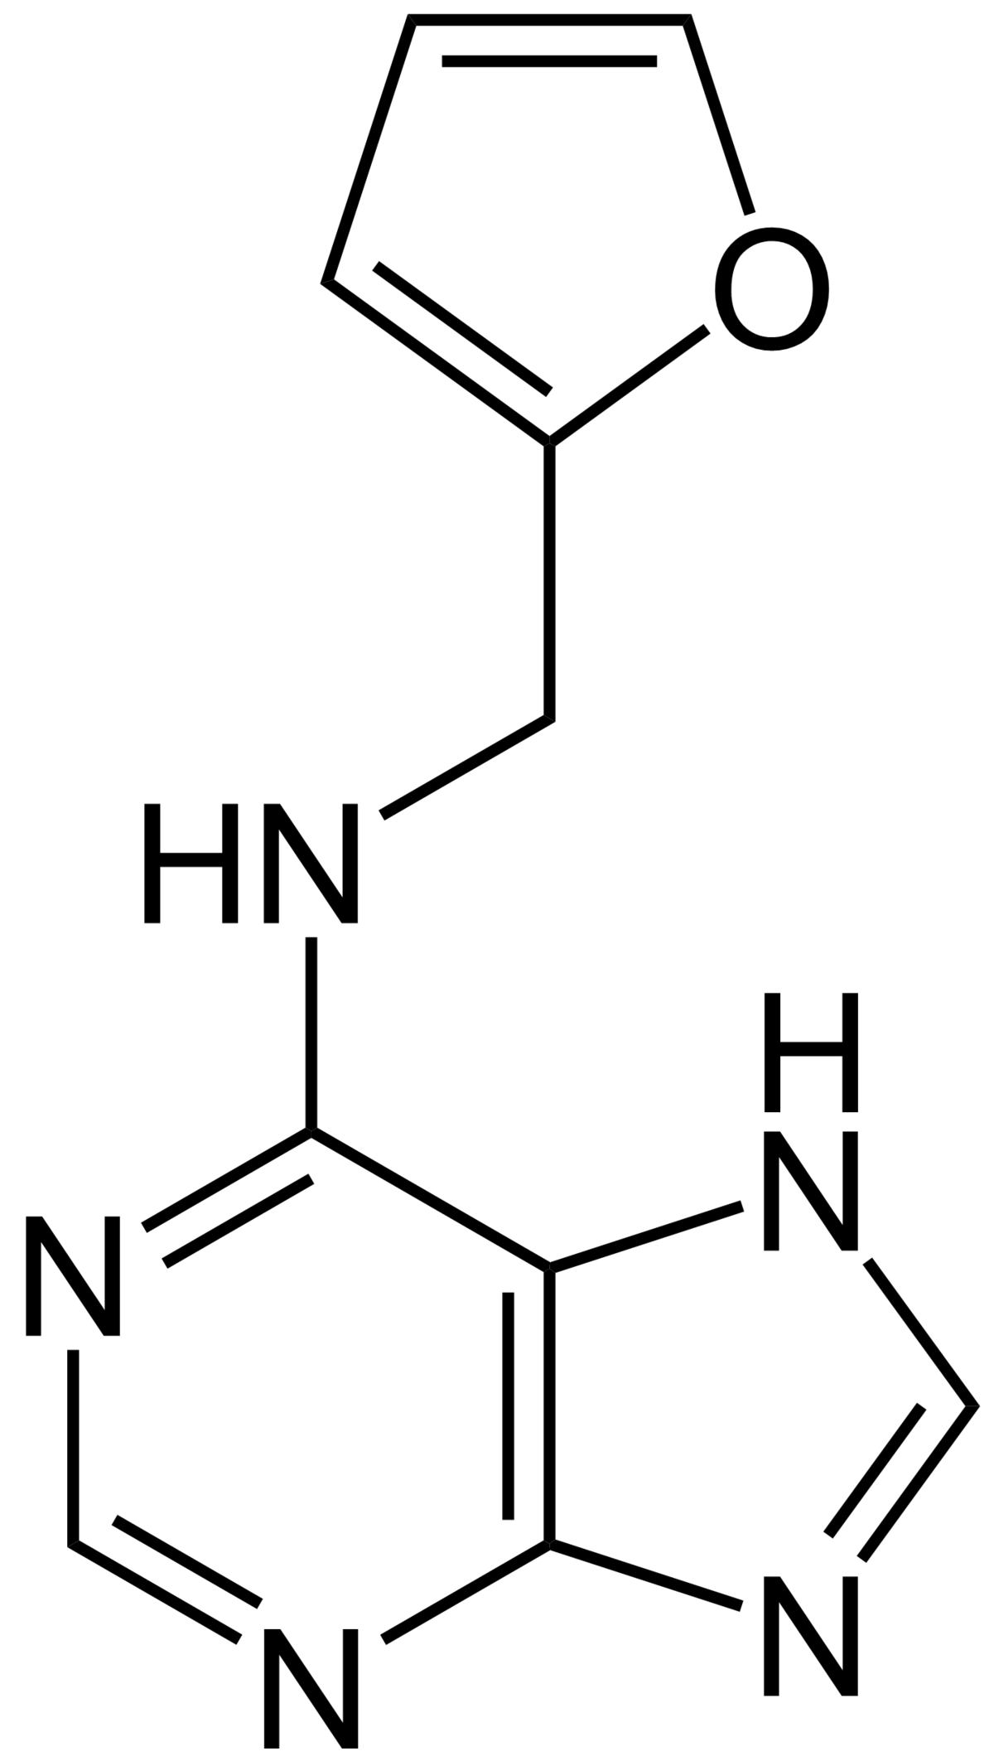
kinetin
According to some studies, one of the strongest inhibitors of the human cell aging process is kinetin, which is a cytokinin found in high concentrations in stem cells of, for example, citrus fruits and raspberries.

Slide 9
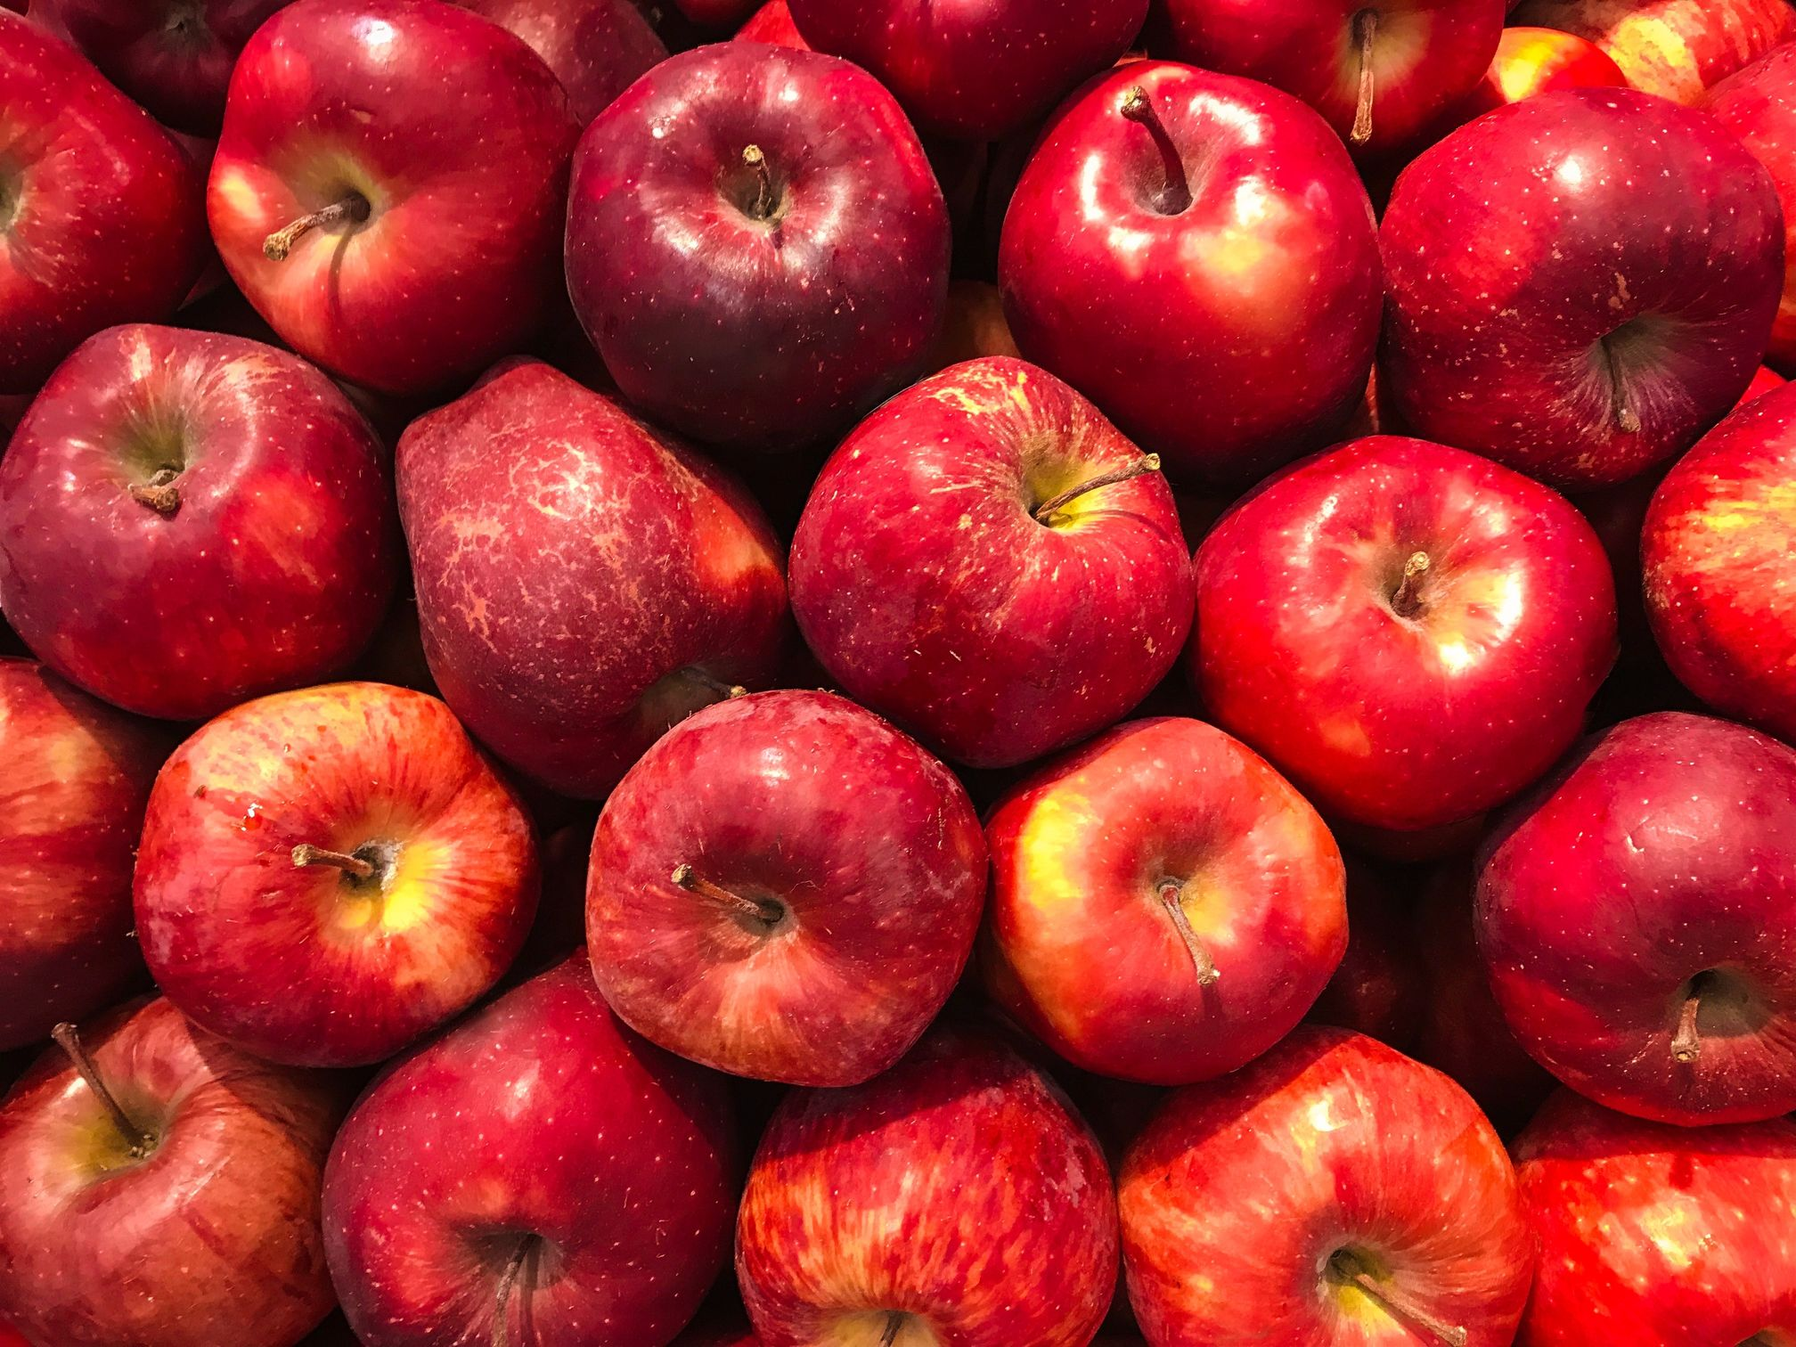
Protecting human stem cells
Uttwiler spatlauber species
It was concluded that 50% of the cells cultured in the growth medium alone died, whereas the cells which were cultured in the presence of an extract of stem cells from Uttwiler spatlauber were found to have experienced only a small loss in terms of their viability.

Slide 10
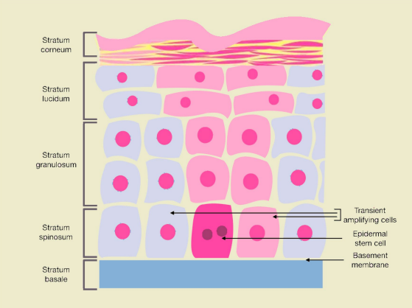
Reversing signs of senescence in fbroblast cells
Senescence is described as a natural process in which after dividing 50 times, the cell loses its ability to undergo any further divisions

Slide 11

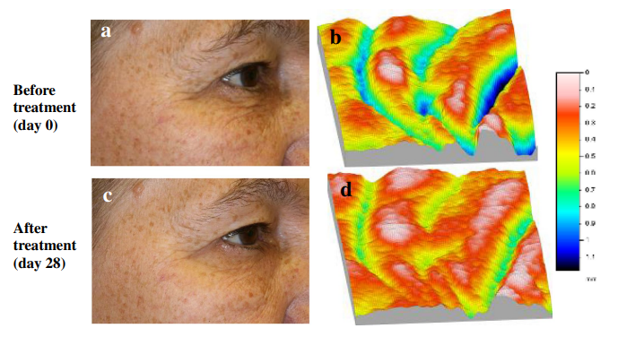
Anti‑wrinkle effect
The application of PhytoCellTecTM Malus domestica cream was reported to markedly reduce the depth of the wrinkle after a period of 2 weeks and then 4 weeks.

Slide 12

Marketed products
tomato
(Lycopersicon
esculentum)
Uttwiler
spatlauber
Leontopodium
alpinum
reversing the process of ageing of skin fbroblast cells
protecting skin from adverse efects caused due to toxicity of heavy metals
anti-collagenase and anti-ageing

Slide 13
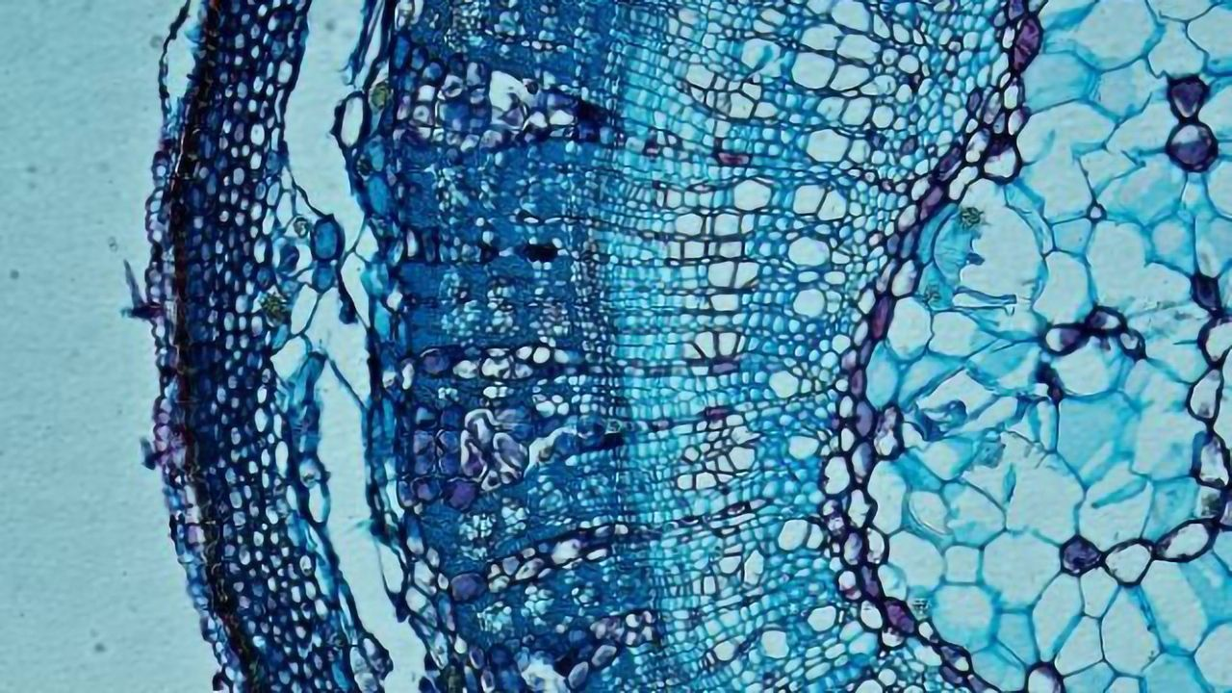
conclusion
The extracts obtained from plant stem cells are a source of many active substances, such as polyphenols, phenolic acids, triterpenes, flavonoids, carotenoids, fatty acids, sugars, and peptides, which give the anti-aging properties.
1
2
It will prove to be a highly rewarding proposition if the genes responsible for conferring the benefcial traits of stem cells on humans are identifed. This would hasten the process of natural healing, achieving yet another goal of the healthcare system.

Slide 14

References
1
Gomes, C., Silva, A. C., Marques, A. C., Sousa Lobo, J., & Amaral, M. H. (2020). Biotechnology applied to cosmetics and aesthetic medicines. Cosmetics, 7(2), 33.
2
Aggarwal, S., Sardana, C., Ozturk, M., & Sarwat, M. (2020). Plant stem cells and their applications: special emphasis on their marketed products. 3 Biotech, 10(7), 1-9.
Krasteva, G., Georgiev, V., & Pavlov, A. (2021). Recent applications of plant cell culture technology in cosmetics and foods. Engineering in life sciences, 21(3-4), 68-76.
3
4
Miastkowska, M., & Sikora, E. (2018). Anti-aging properties of plant stem cell extracts. Cosmetics, 5(4), 55.

