Slide 1
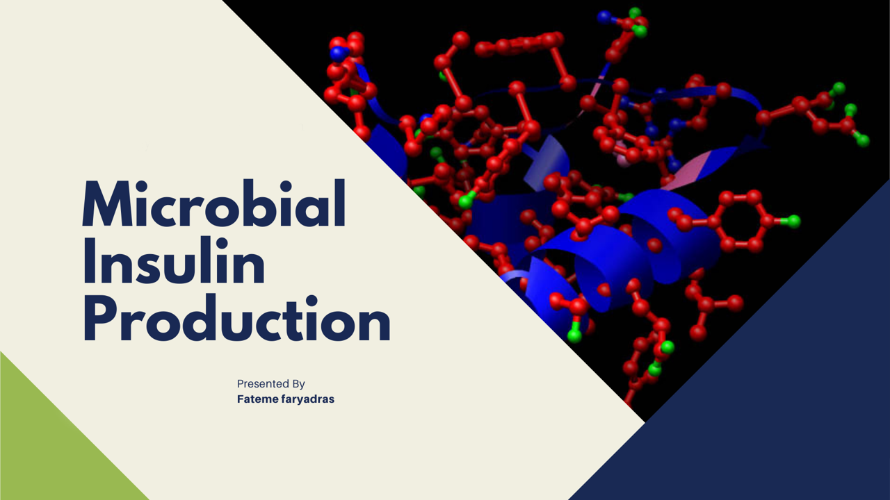

Slide 2
contents
Introduction
History
Structure, function and synthesis of insulin
Insulin production by Recombinant DNA technology: Two-chain method
Bio-production Steps
Different Expression Systems of insulin
Conclusion
References

Slide 3
Introduction
rapid increase in the number of diabetic patients
limitation in production capacity
high production cost
the demand for recombinant insulin
Recombinant human insulin has been produced predominantly using
E. coli and Saccharomyces cerevisiae for therapeutic use in human.

Slide 4
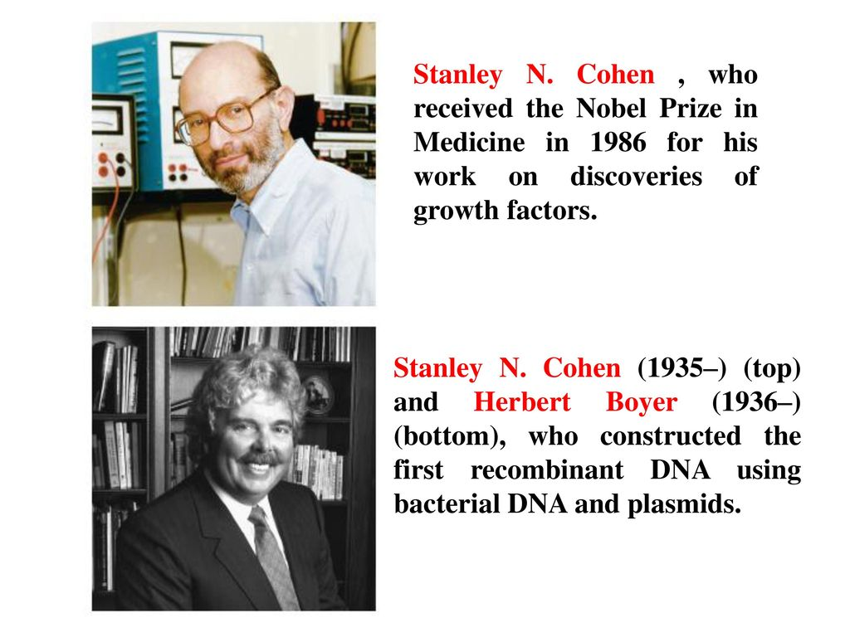
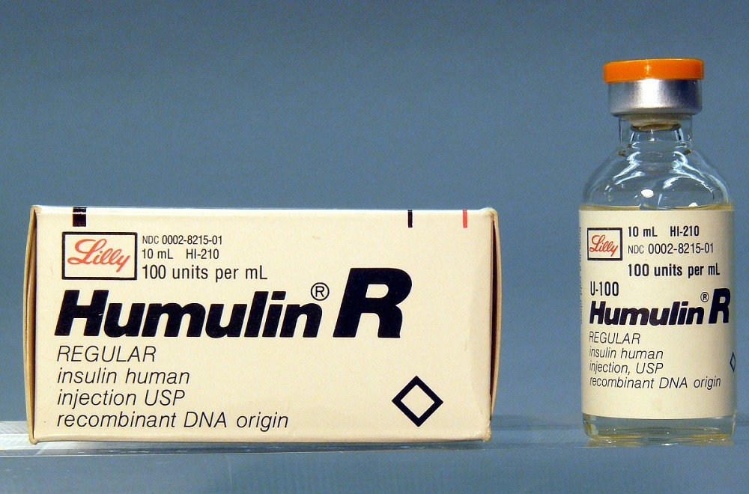

History

Slide 5
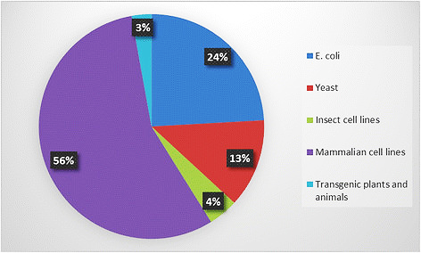
Biopharmaceutical products
Therapeutic monoclonal antibodies
the hormones
growth factors

Slide 6
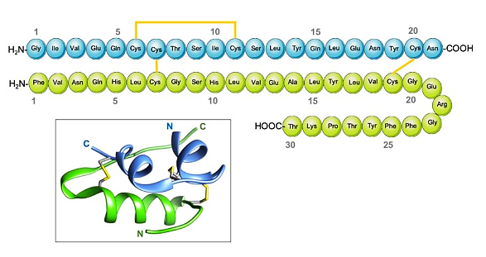
Structure and function of insulin

Slide 7
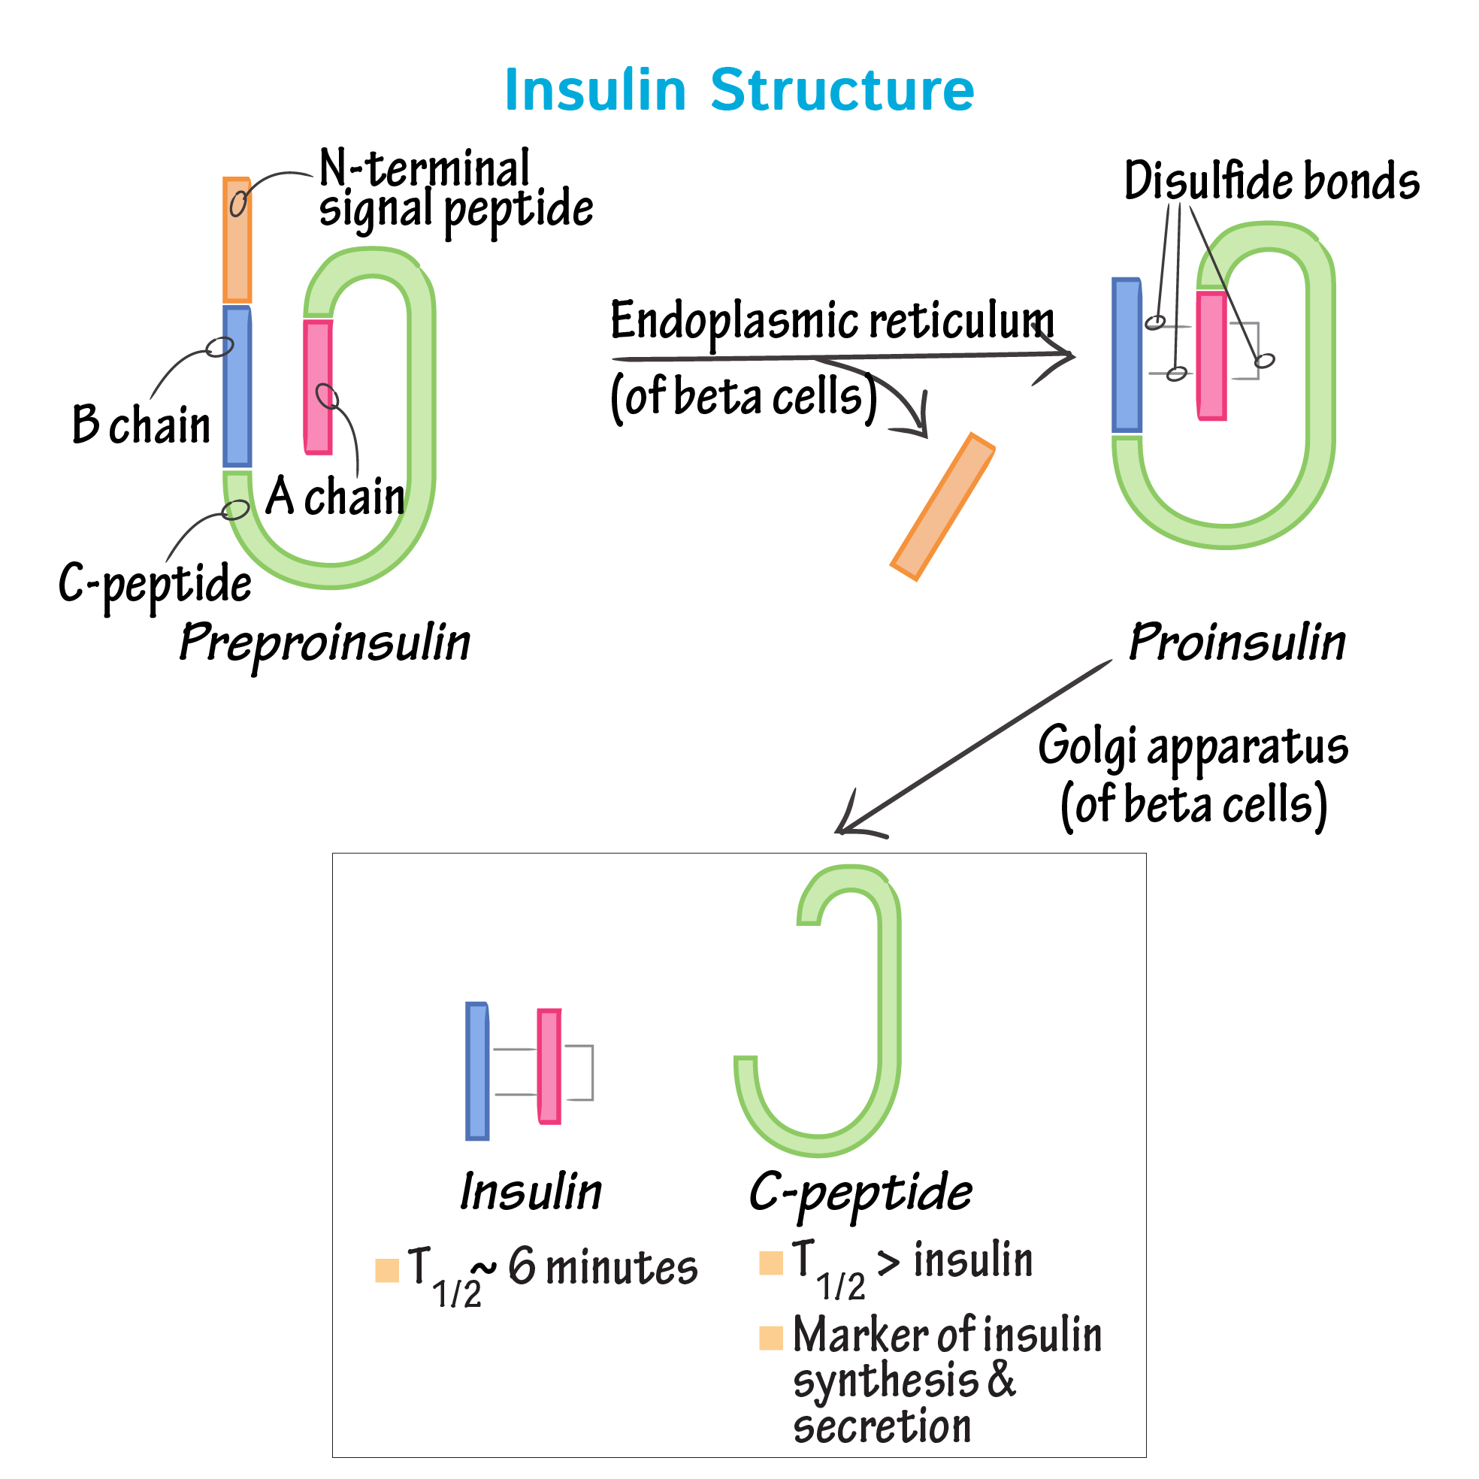
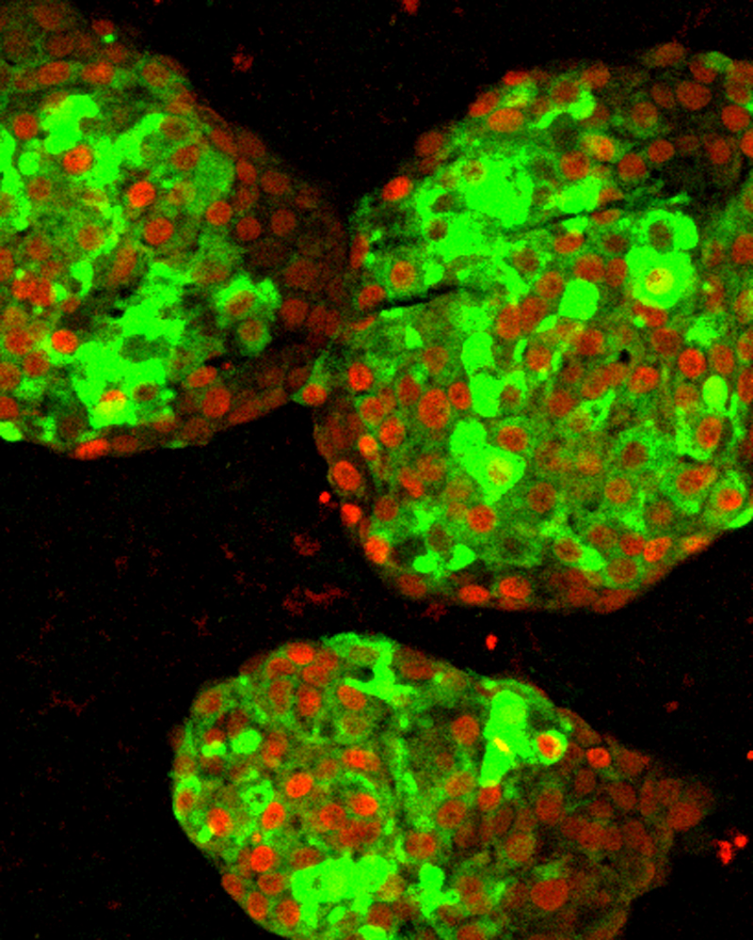
Insulin synthesis

Slide 8
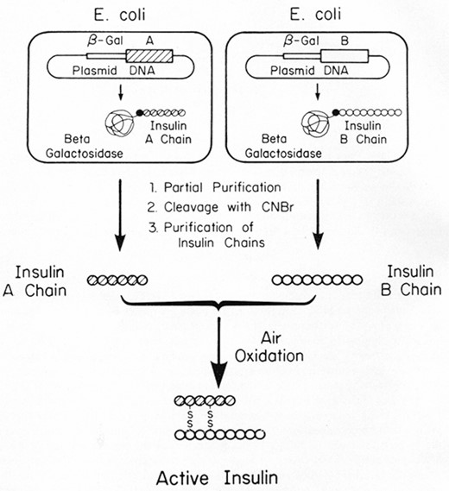
Insulin production by Recombinant DNA technology: Two-chain method

Slide 9
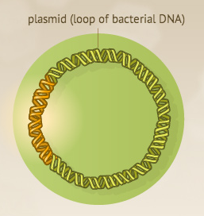
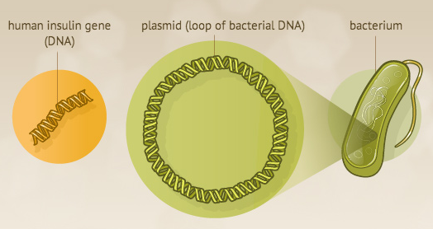
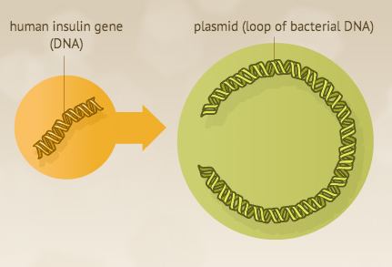
Bio-production Steps
Gene Isolation
Insertion into the Plasmid

Slide 10
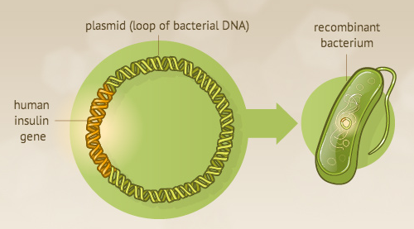
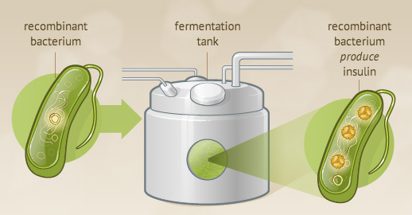
Bio-production Steps
3. Transfection
4. Medium Preparation
5. Bioreactor Fermentation

Slide 11
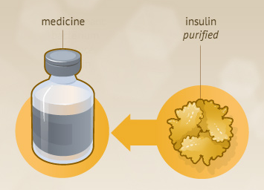
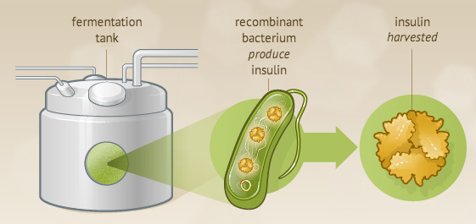
Bio-production Steps
6. Crude Product Isolation
7. Purification
9. Chain Joining

Slide 12
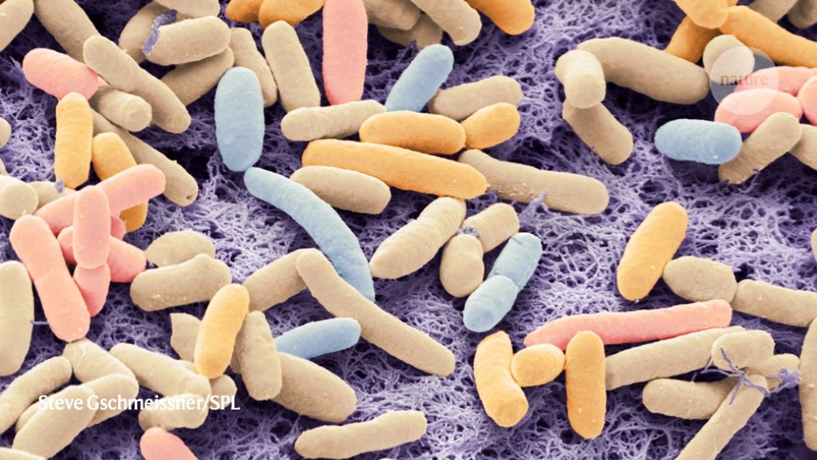
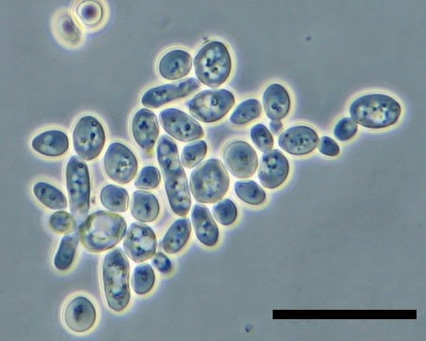
Different Expression Systems of insulin
E. coli
Yeast:
  Saccharomyces cerevisiae
  Pichia pastoris
Transgenic Plants:
  Arabidopsis thaliana
  Tobacco and Lettuce Plants
  Strawberry Plant

Slide 13
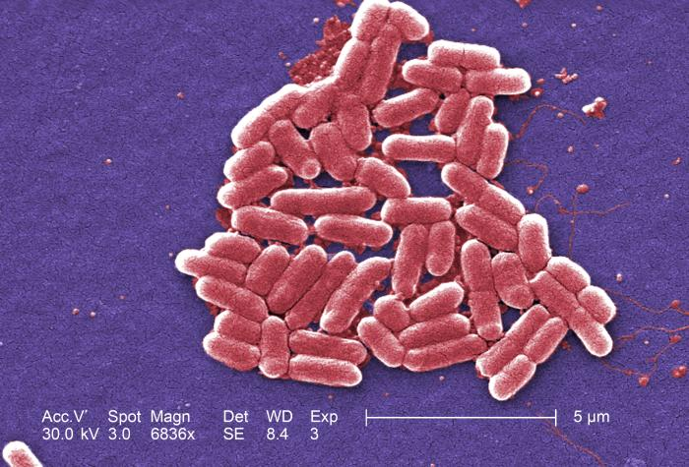
E. coli
the first expression system used to produce human insulin in 1978
Advantages
Disadvantages
new technologies to solve problems

Slide 14
Yeast
another commercially-used expression system for heterogeneous protein production with recombinant technology because of its PTMs.
Advantages
Disadvantage:
proteins synthesized in yeast have high-mannose
N-glycosylation
activates an immune response in humans
shortens the half-life of recombinant proteins in vivo

Slide 15
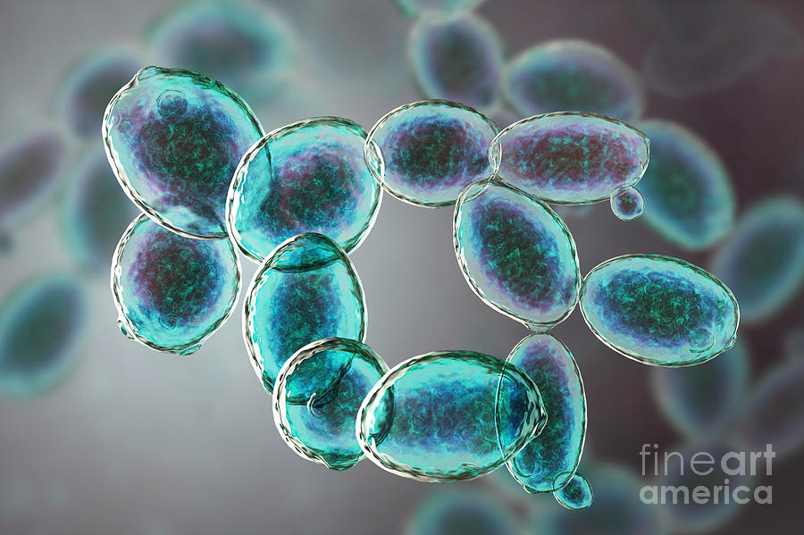
  Yeast: Saccharomyces cerevisiae
Produce:
  Proinsulin
  Fast-acting insulin
  Long-acting insulin

Slide 16
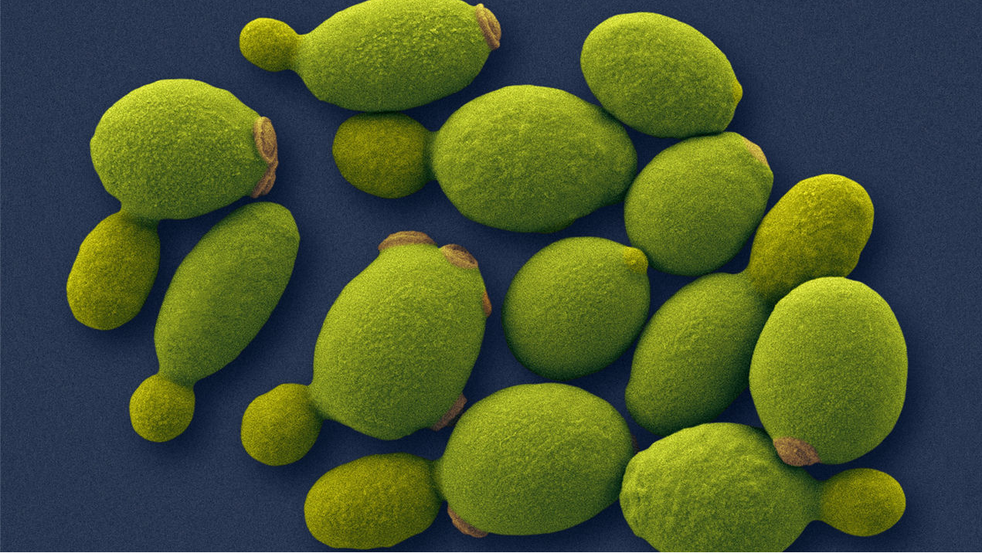
  Yeast: Pichia pastoris
presence of the methanol-inducible alcohol oxidase-1 promoter (AOX-1)
Heterogeneous protein expression attained by P. pastoris is approximately 30% of its total cell protein

Slide 17
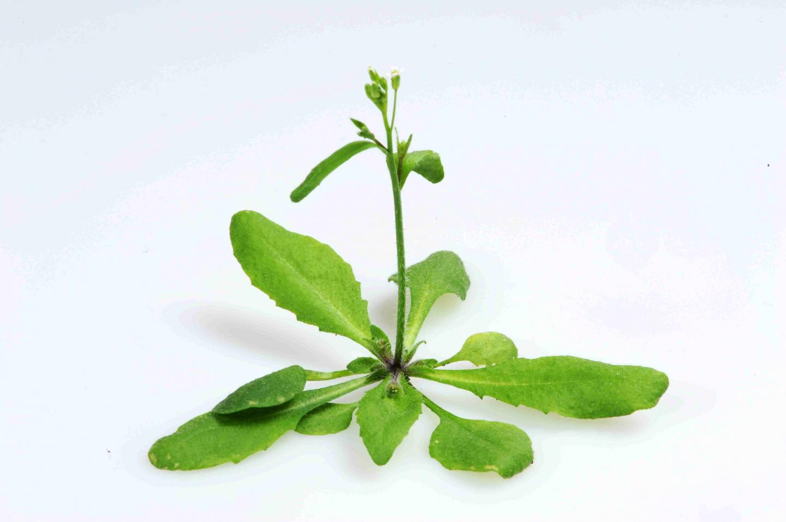
Transgenic Plants
Plants do not have human pathogens and because they are eukaryotic, their PTM machinery is more similar to humans than that previously described in yeast.
Arabidopsis thaliana
Tobacco and Lettuce Plants
Strawberry Plant

Slide 18
Conclusion
Dietary and lifestyle changes are causing dramatic increase in diabetes incidence all over the world.
Both Type I and Type II diabetic patients use insulin, however late stage Type II diabetes patients require large doses of insulin as they develop insulin resistance.
Current manufacturing technologies will not be able to meet the growing demand of insulin due to limitation in production capacity and high production cost.

Slide 19
References
Baeshen, N. A., Baeshen, M. N., Sheikh, A., Bora, R. S., Ahmed, M. M. M., Ramadan, H. A., ... & Redwan, E. M. (2014). Cell factories for insulin production. Microbial cell factories, 13(1), 1-9.
Alyas, J., Rafiq, A., Amir, H., Khan, S. U., Sultana, T., Ali, A., ... & Ahmad, A. (2021). Human Insulin: History, Recent Advances, and Expression Systems for Mass Production. Biomedical Research and Therapy, 8(9), 4540-4561.
Riggs, A. D. (2021). Making, Cloning, and the Expression of Human Insulin Genes in Bacteria: The Path to Humulin. Endocrine Reviews, 42(3), 374-380.

