Slide 1












The Cutting Edge of Industry: Applications of Genetic Engineering
By: Mahdi Morshedi Yekta and Fatemeh Faryadras
Notes:
Welcome everyone! Today, we’ll delve into the fascinating world of genetic engineering and explore its groundbreaking applications that are revolutionizing various industries. We’ll see how this technology is making processes more efficient, sustainable, and creating new products that benefit our lives.

Slide 2
INTRODUCTION

Slide 3

What is Genetic Engineering?
Genetic engineering, also known as recombinant DNA technology, manipulates the genetic makeup of an organism.
Scientists can insert, remove, or change specific genes to create organisms with desired traits.
This has numerous applications in medicine, agriculture, and industry.
Ref: https://www.nbcnews.com/health/health-news/new-gene-editing-systems-are-more-precise-n814446
Notes:
تعریف علوم مهندسی ژنتیک
نحوه عملکرد محققان برای ساخت ارگانیسم ویژه
حوزه های فعالتیی مهندسی ژنتیک

Slide 4
Tools and Techniques in Genetic Engineering
CRISPR-Cas9 Technology: The revolutionary CRISPR-Cas9 system enables precise gene editing, allowing scientists to modify DNA sequences with unprecedented accuracy and efficiency.
Gene Insertion and Silencing: Techniques such as gene insertion and gene silencing play a pivotal role in altering the expression of specific traits, providing opportunities for tailored genetic modifications.
Genetic Modification in Microorganisms: Genetic engineering is extensively utilized in microorganisms to enhance their capabilities for industrial processes, including the production of biofuels and biodegradable products.
Notes:
اکتینوباکتری های وتولید متابولیت ثانویه

Slide 5
Engineered Products for Human Health

Slide 6
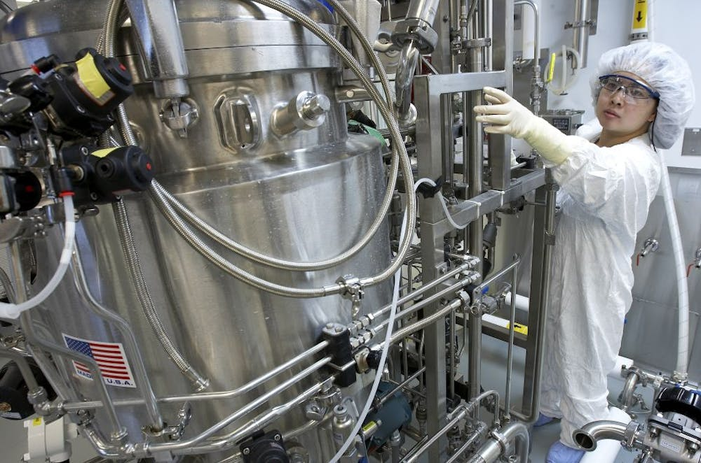
Pharmaceutical Industry
Genetic engineering has been used to mass-produce various drugs, including insulin, human growth hormones, follistim (for treating infertility), human albumin, monoclonal antibodies, antihemophilic factors, vaccines, and many other drugs.

Slide 7

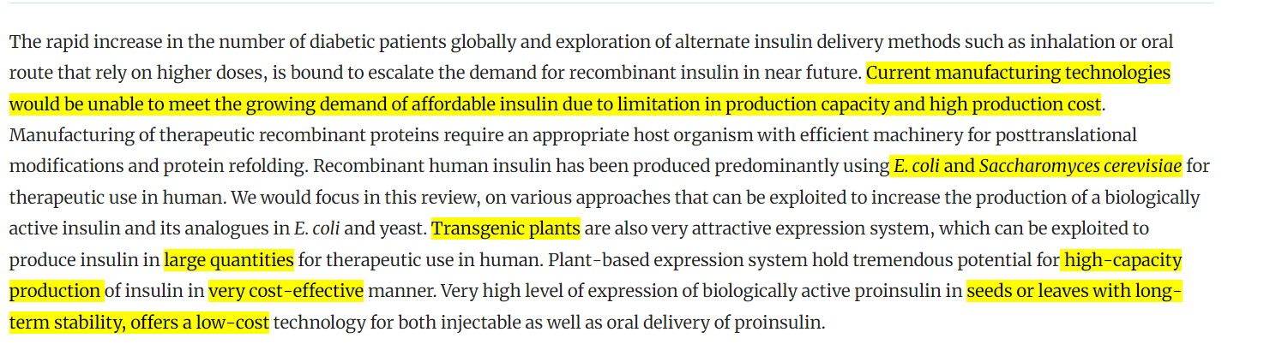

Slide 8
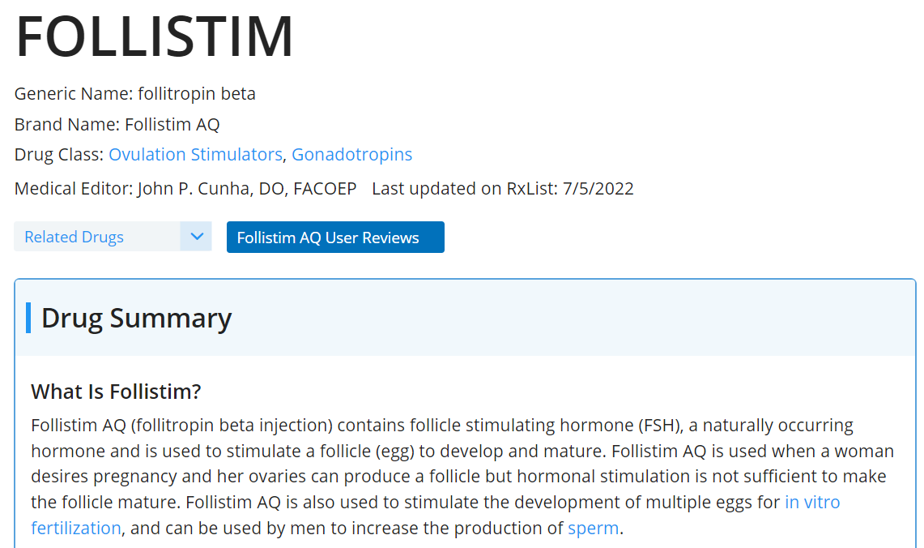
Ref: https://www.rxlist.com/follistim-drug.htm

Slide 9
Impact on Healthcare Industry
Advancements in Medical Science: Genetic engineering has led to significant advancements in medical science, offering new approaches to treating diseases, improving patient outcomes, and shaping the future of healthcare.
Potential for Personalized Medicine: The use of genetically engineered products opens the door to personalized medicine, with tailored treatments based on individual genetic profiles, revolutionizing healthcare practices.

Slide 10
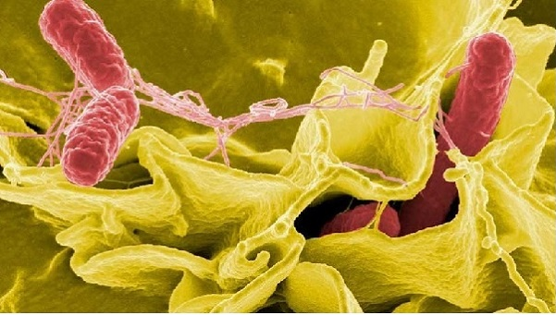
Bio-Hydrometallurgy:
Harnessing Microbes for Metal Magic
Ref: https://atriainnovation.com/en/blog/biohydrometallurgy-the-recycling-of-the-future/

Slide 11
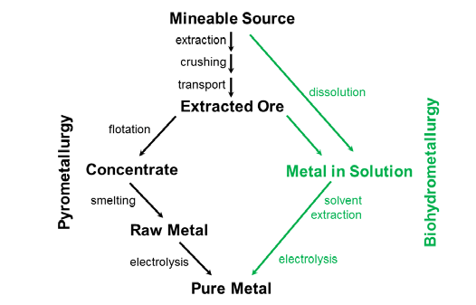
What is Bio-Hydrometallurgy?
Bio-hydrometallurgy leverages microbial activity to dissolve metals from their ores.
Microbes like Fungi and bacteria(archaea) play a crucial role in this process.
They break down minerals, releasing the target metals into a solution.
Ref: https://www.researchgate.net/publication/324727581
Notes:
ارکی باکتری های بخاطر توانایی زیست در شرایط سخت رو دارند
رسوبی و آذرین هستند

Slide 12
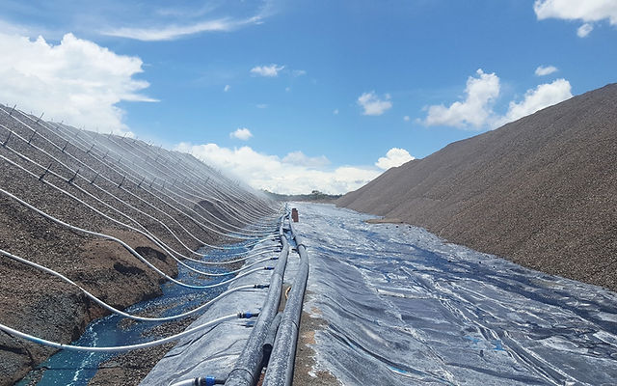
Applications in Metal Mining
Bio-heap leaching: Crushed ore is piled onto heaps and inoculated with microbes.
Microbes gradually dissolve target metals like copper and gold from the ore.
The metal-laden solution is then collected for further processing.
Notes:
One of the major applications of bio-hydrometallurgy lies in metal mining. Bio-heap leaching is a widely used technique where crushed ore is stacked in massive heaps. These heaps are then sprinkled with a solution containing specially chosen microbes. Over time, these microbes work their magic, dissolving the desired metals from the ore particles. The resulting metal-rich solution is then collected and processed to extract the pure metals. This method is particularly beneficial for low-grade ores that might not be economical to process using conventional methods.pen_spark

Slide 13
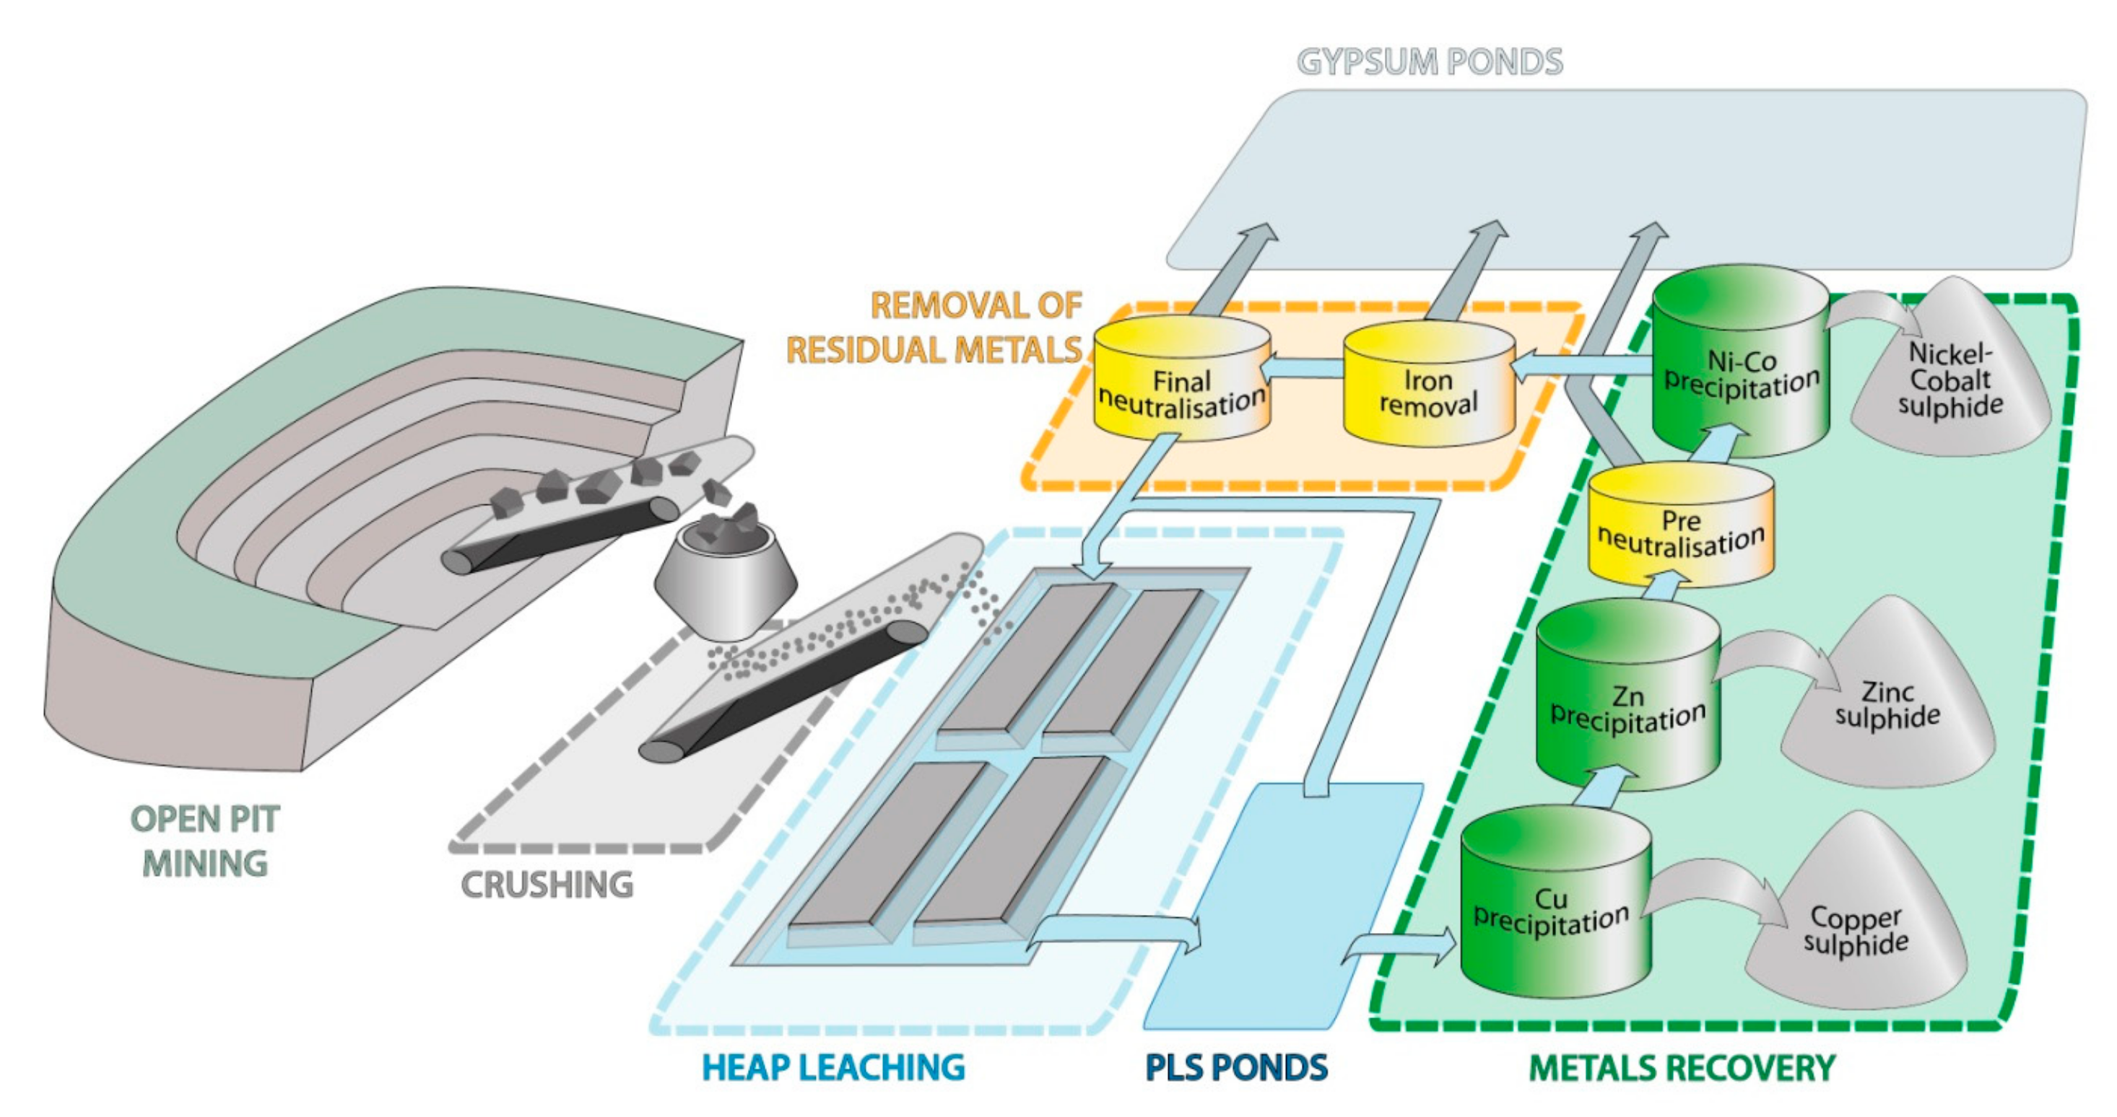
Ref: https://www.mdpi.com/2076-3263/8/2/66

Slide 14

Ref: https://atriainnovation.com/en/blog/biohydrometallurgy-the-recycling-of-the-future/

Slide 15
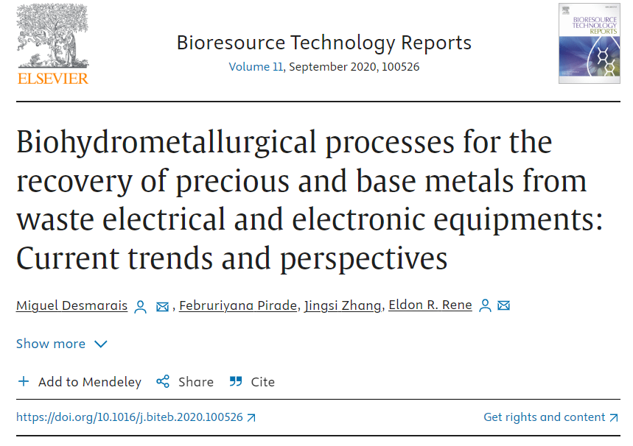
Bio-Hydrometallurgy for E-Waste Recycling
E-waste contains valuable metals like gold, silver, and palladium.
Bio-hydrometallurgy offers a cleaner alternative for e-waste recycling.
It breaks down e-waste components, allowing for metal recovery.
Ref: https://www.sciencedirect.com/science/article/abs/pii/S2589014X2030147X
Notes:
With the ever-growing problem of electronic waste (e-waste), bio-hydrometallurgy offers a glimmer of hope. E-waste is a treasure trove of valuable metals like gold, silver, and palladium. Bio-hydrometallurgy provides a more environmentally friendly approach to e-waste recycling. By utilizing microbes to break down the complex components of e-waste, it allows for the efficient extraction of these valuable metals. This not only conserves natural resources but also reduces the environmental impact of traditional recycling methods

Slide 16
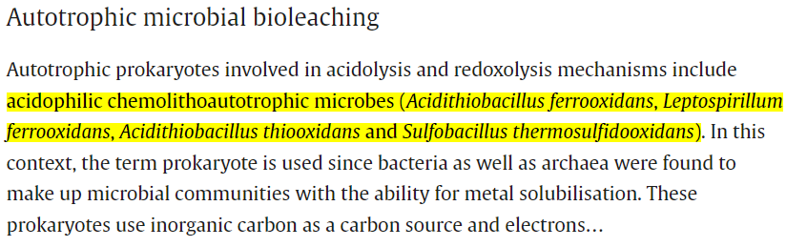
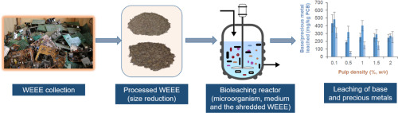
Ref: https://www.sciencedirect.com/science/article/abs/pii/S2589014X2030147X

Slide 17
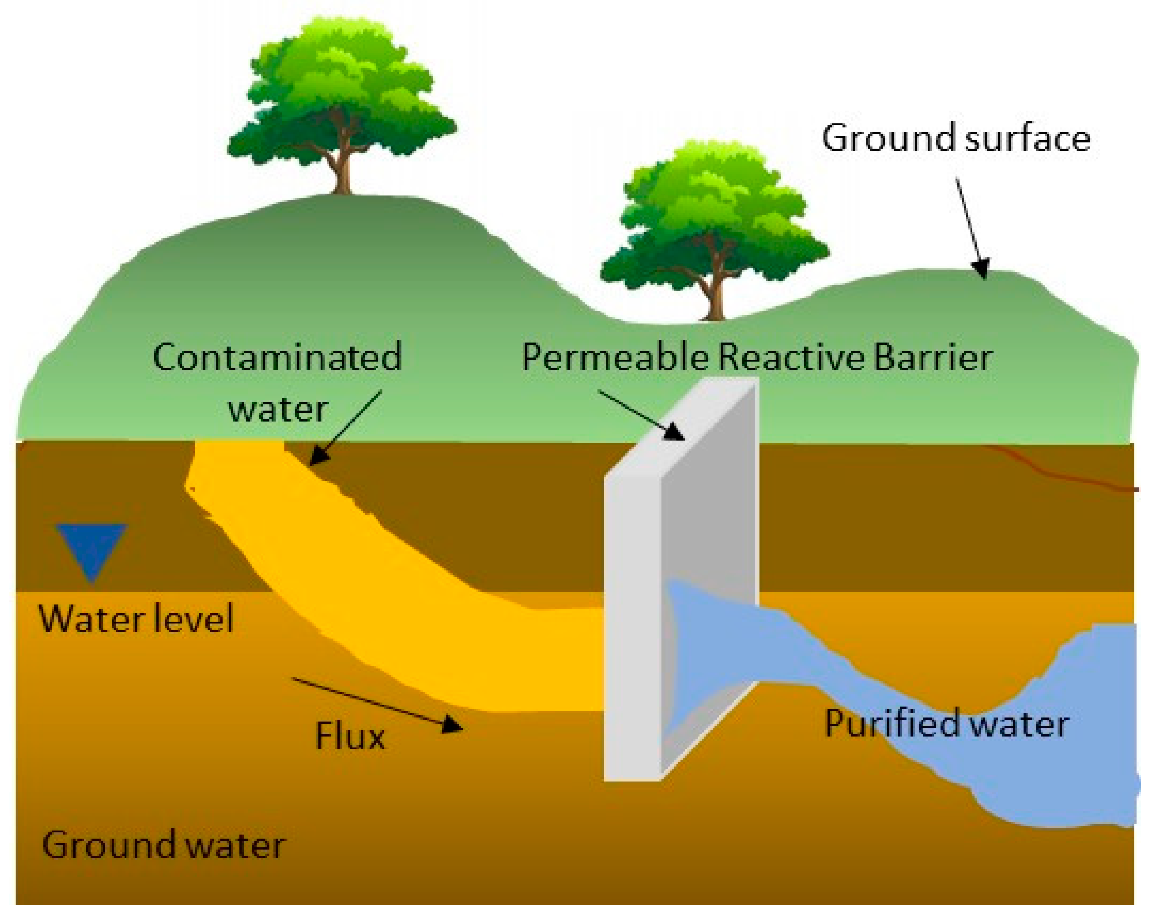
Bioremediation: Cleaning Up with Microbes
bio-hydrometallurgy can be used for bioremediation of metal-contaminated sites.
Microbes help to detoxify the soil by immobilizing or transforming the metals.
Contaminated soil and water often pose a significant threat due to the presence of heavy metals.
This reduces the risk of metal leaching into the environment.
https://www.mdpi.com/1996-1073/13/18/4664
Notes:
Bio-hydrometallurgy isn't just about extracting metals; it can also be a powerful tool for environmental cleanup. Contaminated soil and water often pose a significant threat due to the presence of heavy metals. Bio-hydrometallurgy offers a bioremediation solution. Here, specific microbes are employed to either immobilize or transform the harmful metals. This process renders them less mobile and toxic, preventing them from leaching into the surrounding environment.

Slide 18
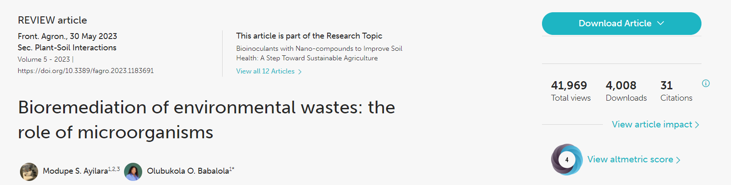
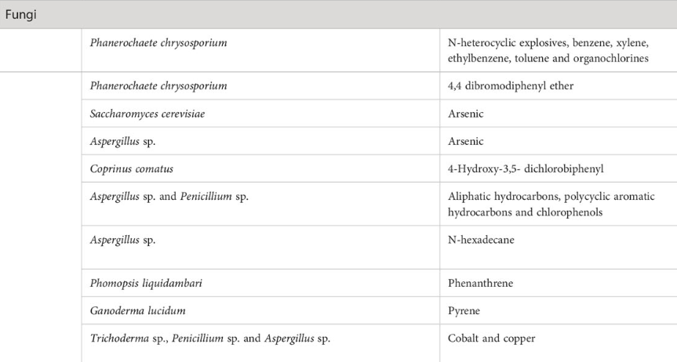
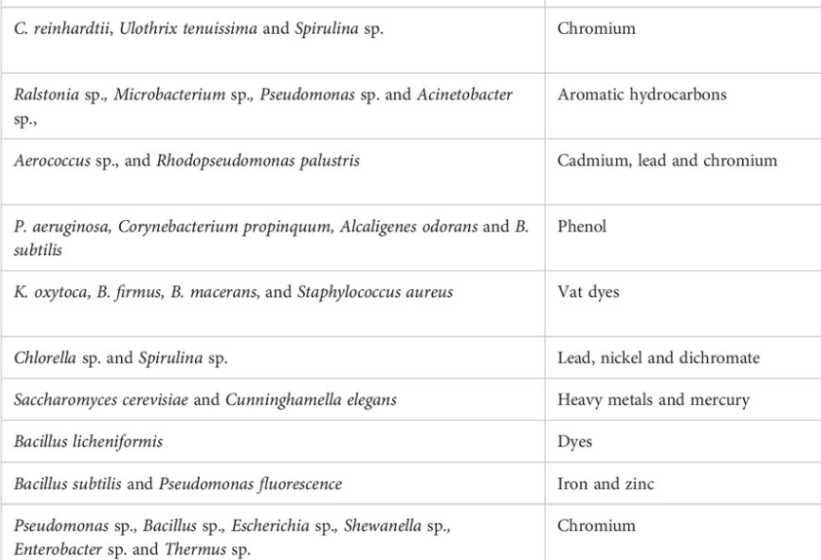
https://doi.org/10.3389/fagro.2023.1183691

Slide 19
Advantages of Bio-Hydrometallurgy
Environmentally friendly: Uses microbes instead of harsh chemicals.
Energy efficient: Operates at lower temperatures compared to traditional methods.
Cost-effective: Can be viable for processing low-grade ores.
Applicable to various metals: Can recover a wide range of metals from different sources.

Slide 20
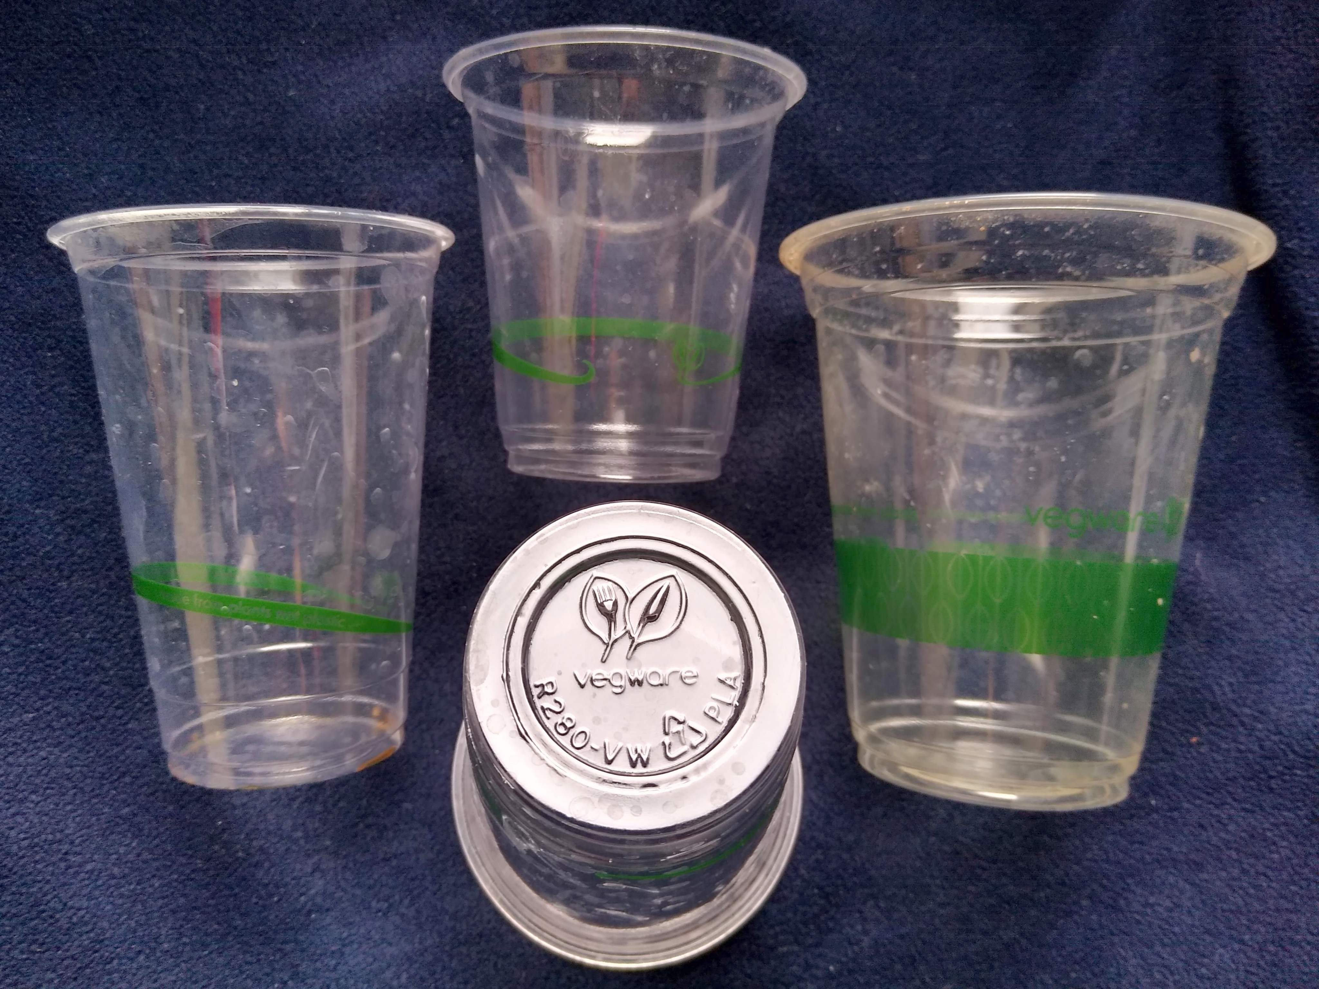
Biodegradable Plastics:
A Sustainable Solution for Industry

Slide 21
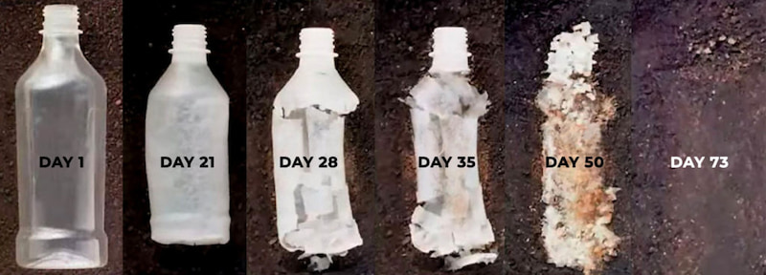
What are Biodegradable Plastics?
Made from renewable resources like corn starch, cellulose, or bacteria.
Degrade by Bacteria and fungi into harmless components like water, CO2, and biomass.
Offer a solution to traditional plastic pollution issues.
Ref: https://europlas.com.vn/en-US/blog-1/how-different-types-of-bioplastics-are-produced
Notes:
Biodegradable plastics are a game-changer in the fight against plastic waste. Unlike traditional plastics derived from fossil fuels, these are crafted from renewable resources like corn starch, cellulose, or even bacteria. The magic lies in their ability to break down naturally under specific conditions. Microorganisms like bacteria and fungi act as decomposers, breaking down these plastics into harmless components like water, carbon dioxide, and biomass. This significantly reduces plastic pollution in landfills and the environment.

Slide 22
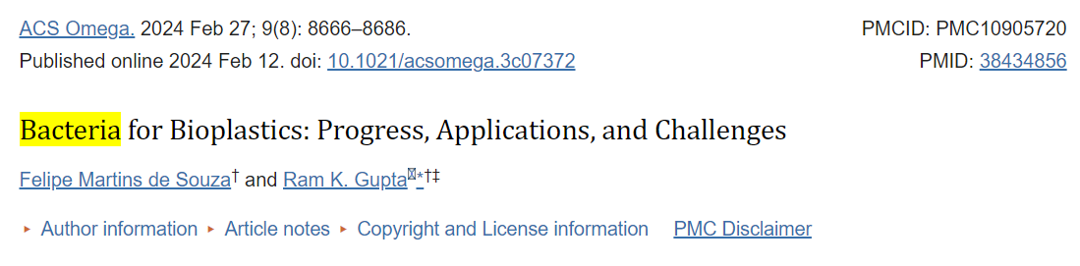
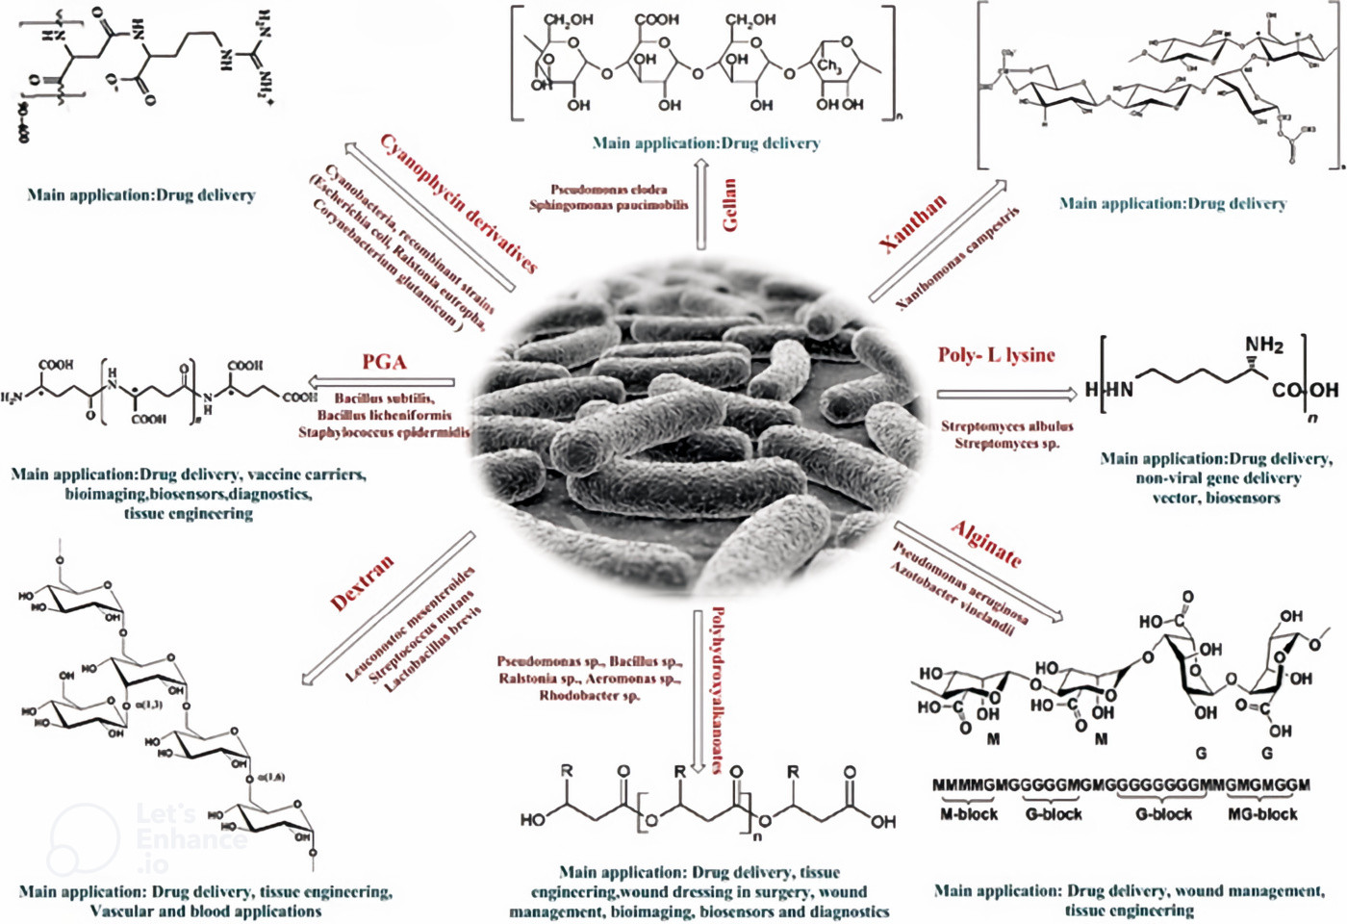
Ref: https://doi.org/10.1021%2Facsomega.3c07372

Slide 23
Applications
Applications in Packaging
Food packaging: Trays, bags, wraps for fruits, vegetables, and baked goods.
Beverage containers: Bottles for water, juices, and other drinks.
Carrier bags: Shopping bags and takeaway containers for restaurants.
Applications in Agriculture & Horticulture
Seedling pots: Biodegradable pots for nurseries and greenhouses.
Crop covers: Protect crops from frost, insects, and harsh weather.
Fashion industry: Clothes made from biodegradable fabrics like PLA.
Medical field: Sutures, surgical tools, and disposable medical equipment.
Electronics industry: Biodegradable casings for electronic devices.
Notes:
Packaging is a massive source of plastic waste. Biodegradable plastics are making significant inroads in this sector. Imagine fruits and vegetables wrapped in clear, yet eco-friendly, biodegradable film. Beverage companies are also adopting biodegradable bottles for water and other drinks. Even shopping bags and takeaway containers can be made from these sustainable materials. This shift not only reduces plastic waste but also promotes responsible consumerism.pen_spark

Slide 24
The Oil Industry:
Powering Modern Industry

Slide 25
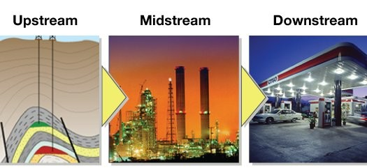
The Three Streams of Oil & Gas
Upstream: Finding and extracting oil & gas
Midstream: Transporting oil & gas
Downstream: Refining oil & gas into products
https://www.linkedin.com/pulse/phases-oil-gas-industry-al-noor
Notes:
The oil and gas industry operates in three main stages: upstream, midstream, and downstream. Upstream companies deal with exploration and extraction – they use sophisticated techniques to locate oil and gas reserves and then drill wells to bring them to the surface. Midstream companies take over from there, transporting the crude oil and gas via pipelines to refineries. Finally, downstream companies are the refiners, who transform the crude oil and gas into a wide range of usable products.pen_spark

Slide 26
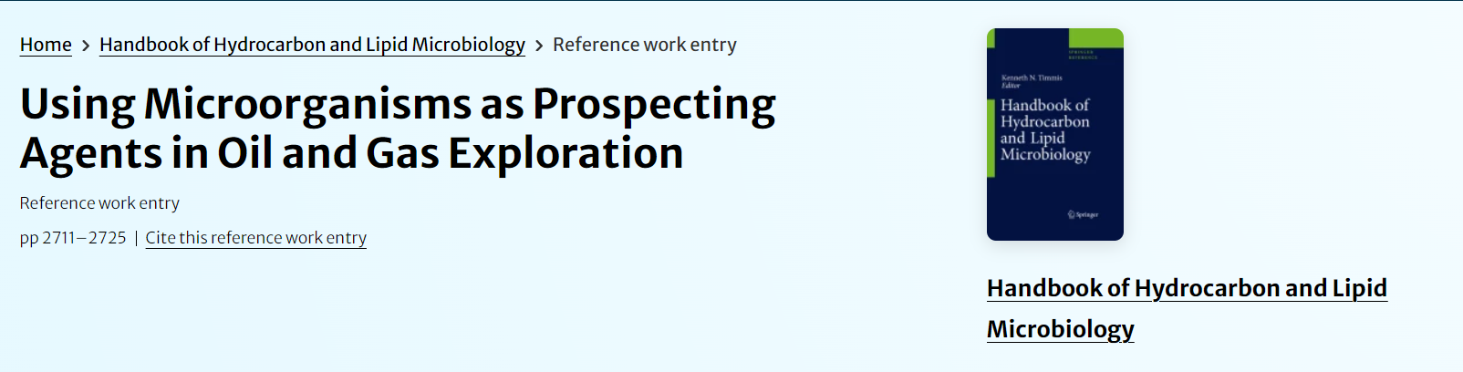
Upstream: Locating the Black Gold
Exploration: Seismic surveys & geological studies
Drilling: Different drilling techniques for various conditions
Ref: https://link.springer.com/referenceworkentry/10.1007/978-3-540-77587-4_201
Notes:
The hunt for oil and gas begins upstream. Exploration teams use cutting-edge technology like seismic surveys to map underground formations and identify potential reservoirs. Geological studies also play a vital role in understanding the rock formations and predicting the likelihood of finding hydrocarbons. Once a promising location is identified, different drilling techniques are employed depending on the specific conditions.pen_spark

Slide 27
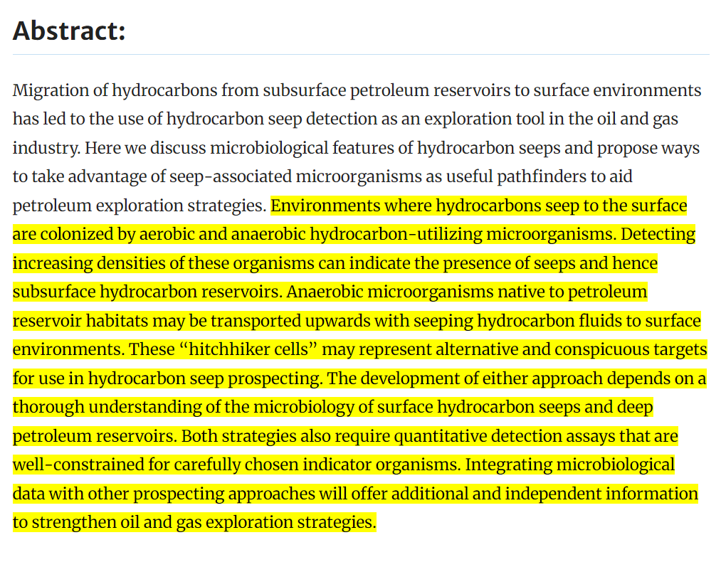
Ref: https://link.springer.com/referenceworkentry/10.1007/978-3-540-77587-4_201

Slide 28
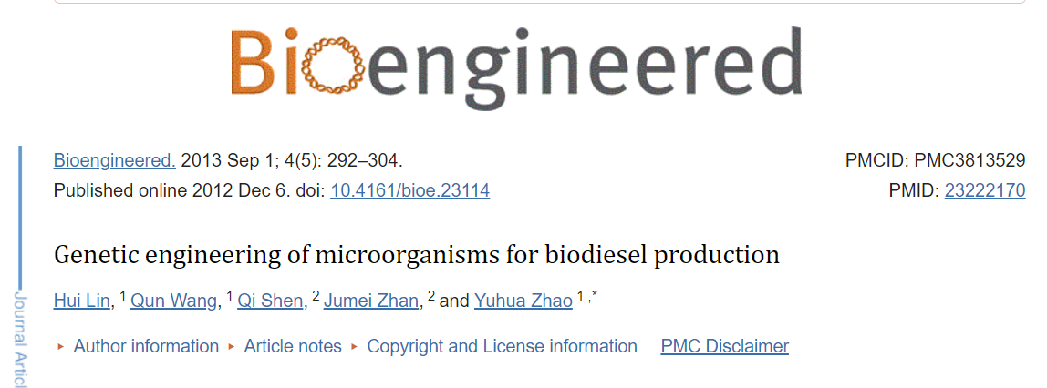
Downstream: The Refinery Hub
Crude oil refining: Separation into various products
Fractional distillation: The core separation process
Ref: https://www.ncbi.nlm.nih.gov/pmc/articles/PMC3813529/
Notes:
Downstream is where the magic happens – crude oil and gas are transformed into a variety of usable products. Refineries are massive industrial complexes equipped with intricate machinery. The core separation process is called fractional distillation, where crude oil is heated, causing its components to separate based on their boiling points. Lighter fractions like gasoline and propane rise to the top, while heavier components like diesel and asphalt remain below.pen_spark

Slide 29
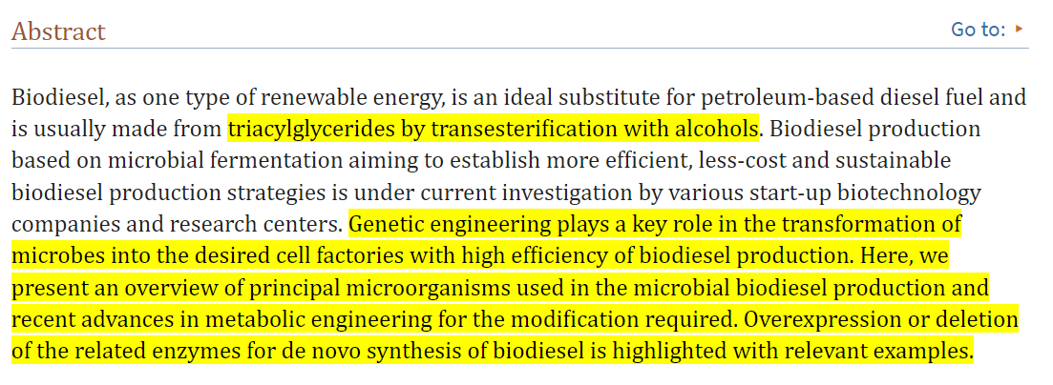
Ref: https://www.ncbi.nlm.nih.gov/pmc/articles/PMC3813529/

Slide 30
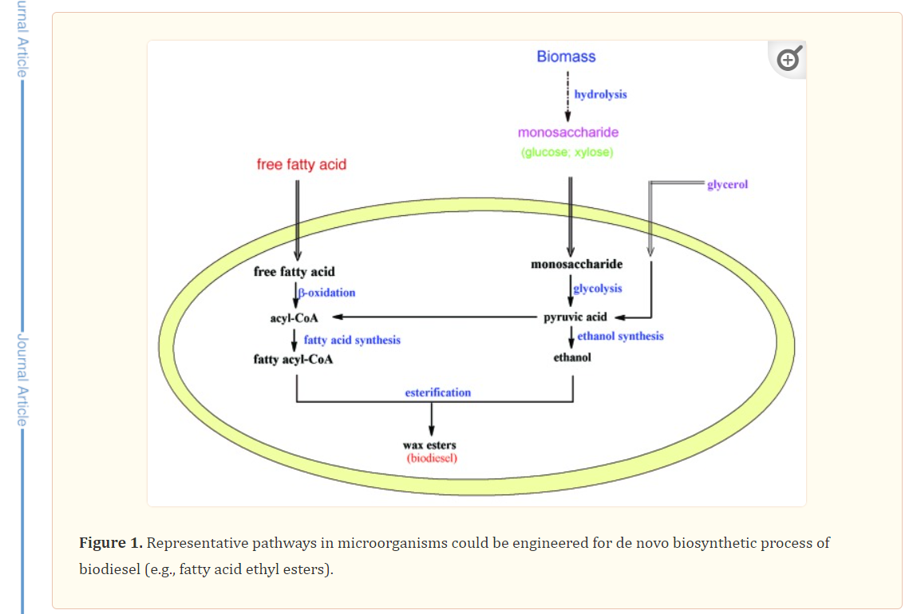
Ref: https://www.ncbi.nlm.nih.gov/pmc/articles/PMC3813529/

Slide 31
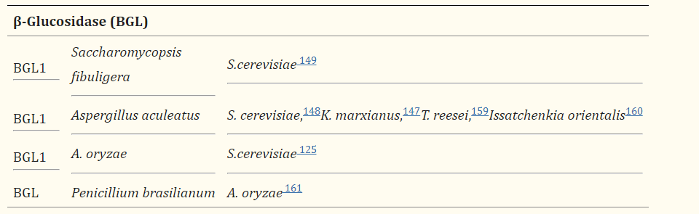
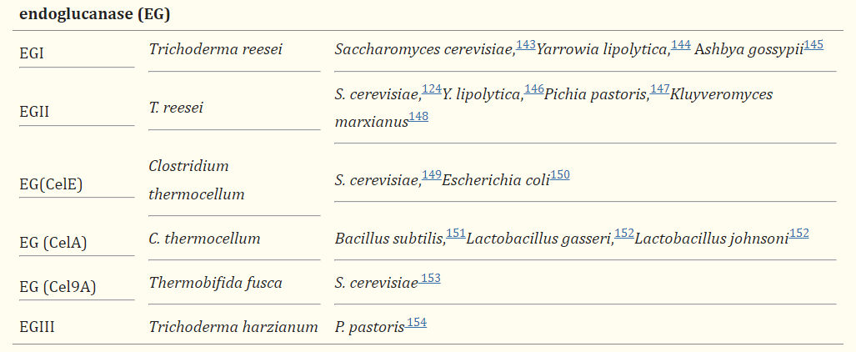
Ref: https://www.ncbi.nlm.nih.gov/pmc/articles/PMC3813529/

Slide 32
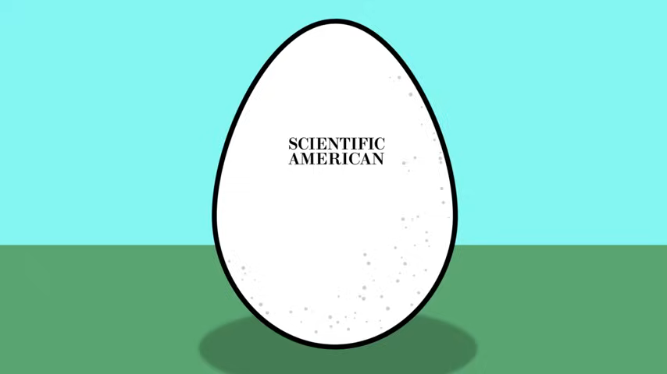
Biotechnology in the Oil Industry
Bioremediation: Cleaning up oil spills
Enhanced oil recovery: Using microbes to extract more oil
Ref: https://www.nature.com/articles/news.2011.191
Ref: https://www.youtube.com/watch?v=a_HWlFzgQiM&ab_channel=ScientificAmerican
Notes:
Biotechnology is making its mark on the oil industry in fascinating ways. Bioremediation utilizes microorganisms to break down oil spills, offering a more natural and sustainable solution for cleaning up environmental contamination. Additionally, scientists are exploring thepen_spark
tuneshare
more_vert

Slide 33
Protein & Enzyme Engineering

Slide 34
Protein Engineering for Industrial Enzyme
Enhancing Enzyme Activity: Protein engineering has enabled the enhancement of industrial enzymes by making them more stable and active, through the introduction of disulfide bonds for stability and modification of active sites for increased biocatalytic ability.
Application in Various Industries: Genetically engineered enzymes find applications in the food industry, animal feed industry, textile manufacture, and detergent production, offering benefits such as reduced use of chemicals and environmental impact.

Slide 35
Advantages of Genetically Engineered Enzymes
Pure Enzyme Production: Genetically engineered enzymes offer the advantage of producing pure enzymes, reducing the use of chemicals in the production process, and minimizing environmental impact.
Reduced Energy Consumption: The use of genetically engineered enzymes in various industries, such as baking, starch manufacture, fruit juices, and detergents, leads to reduced energy consumption and waste, contributing to sustainable practices.
Specificity and Bulk Production: Genetically engineered enzymes are highly specific for their target, can be produced in bulk, and have the ability to increase the shelf life of final products, thus reducing food loss.

Slide 36
Environmental and Economic Impact
Reduction of Phosphorus Release: Genetically engineered enzymes contribute to the reduction of phosphorus release in the environment, particularly in the animal feed industry, promoting sustainable practices.
Economic Benefits: The use of genetically engineered enzymes provides economic benefits through reduced energy consumption, waste reduction, and improved product quality in various industries.

Slide 37
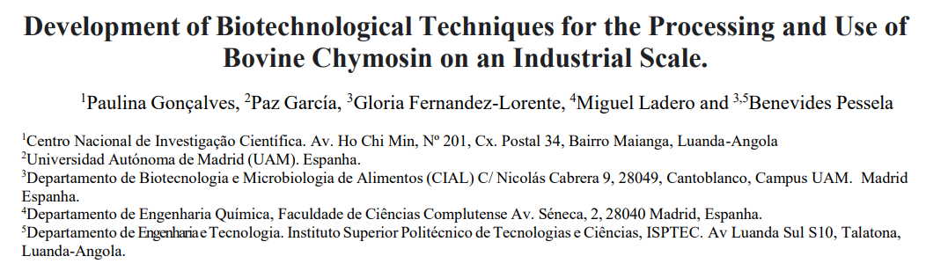
Examples of Genetically Engineered Enzymes
Chymosin for Cheese Production: Genetically engineered chymosin used in cheese production offers predictability, purity, and is preferred by vegetarians and certain religious organizations.

Slide 38
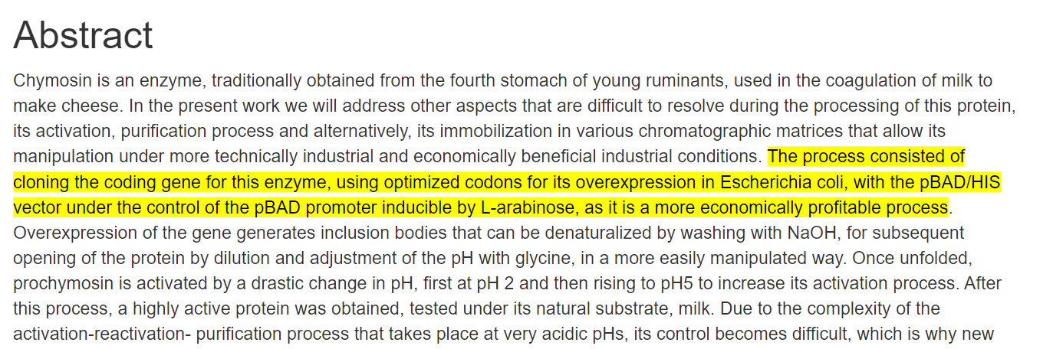
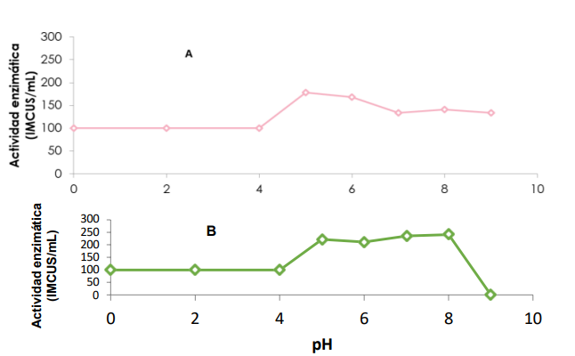

Slide 39

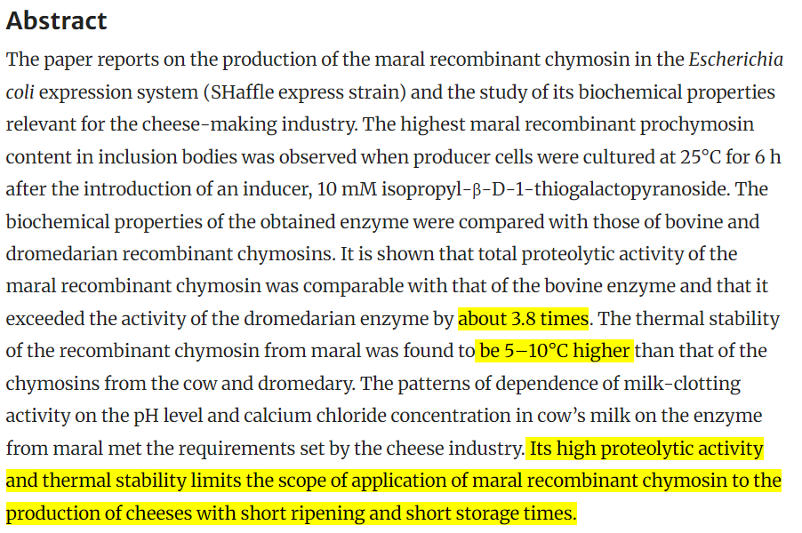
https://doi.org/10.3390/biology11111545

Slide 40
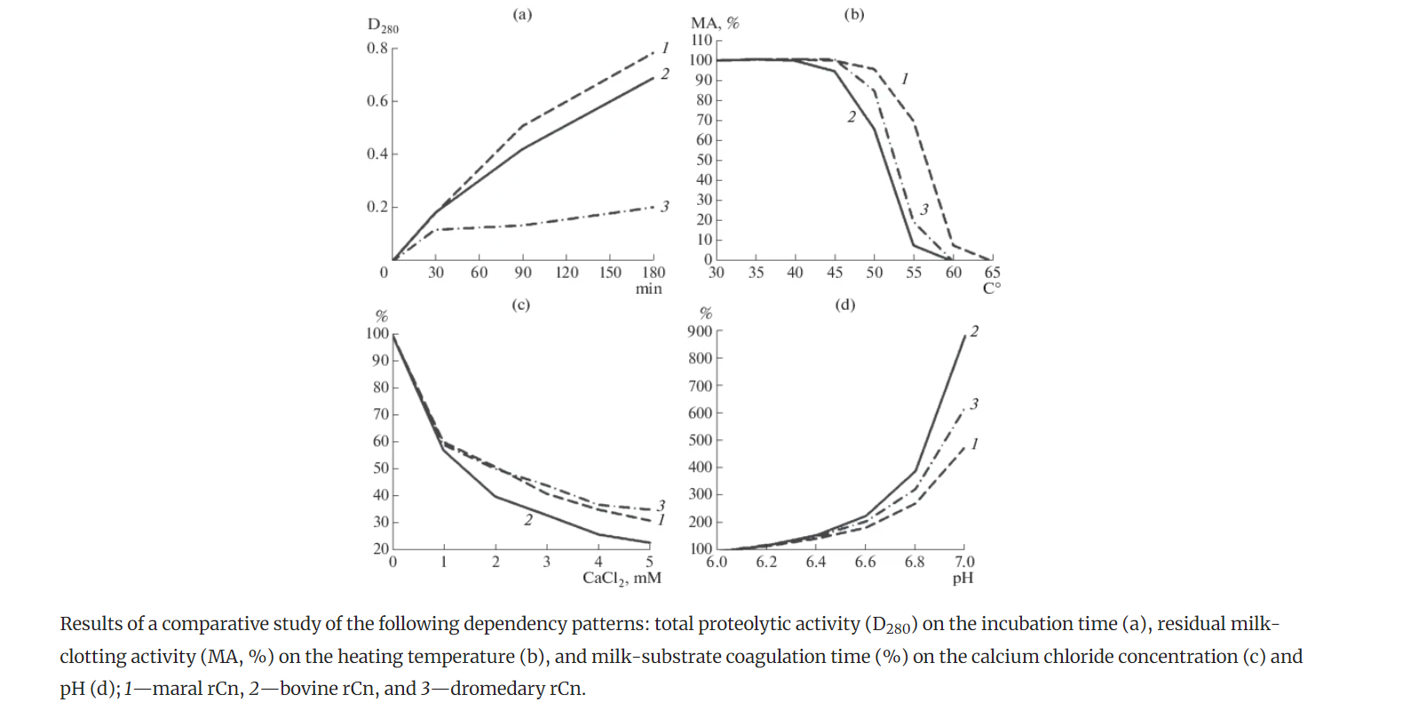
https://doi.org/10.3390/biology11111545

Slide 41
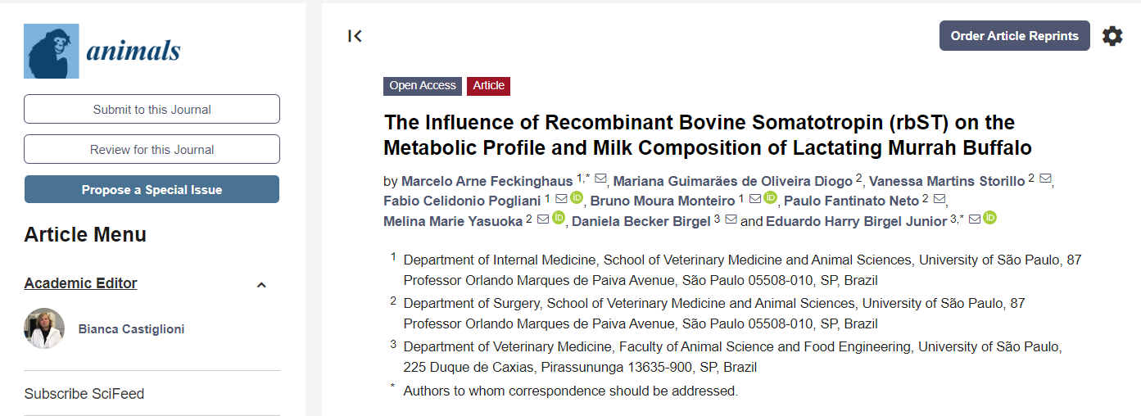
Bovine Somatotropin (BST) for Milk Production: Genetically engineered BST enhances milk production in adult cows, offering benefits to milk producers and contributing to the dairy industry.
https://doi.org/10.3390/ani14040636

Slide 42
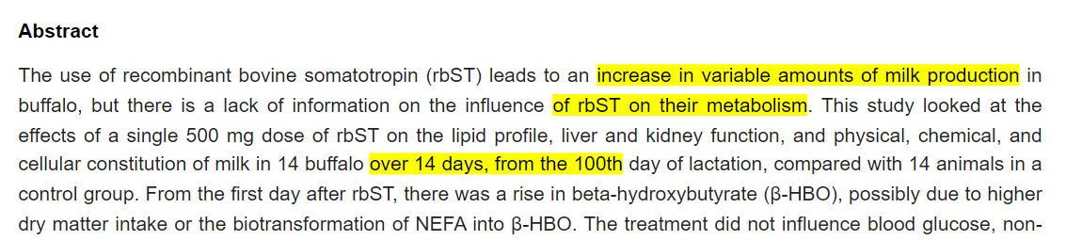
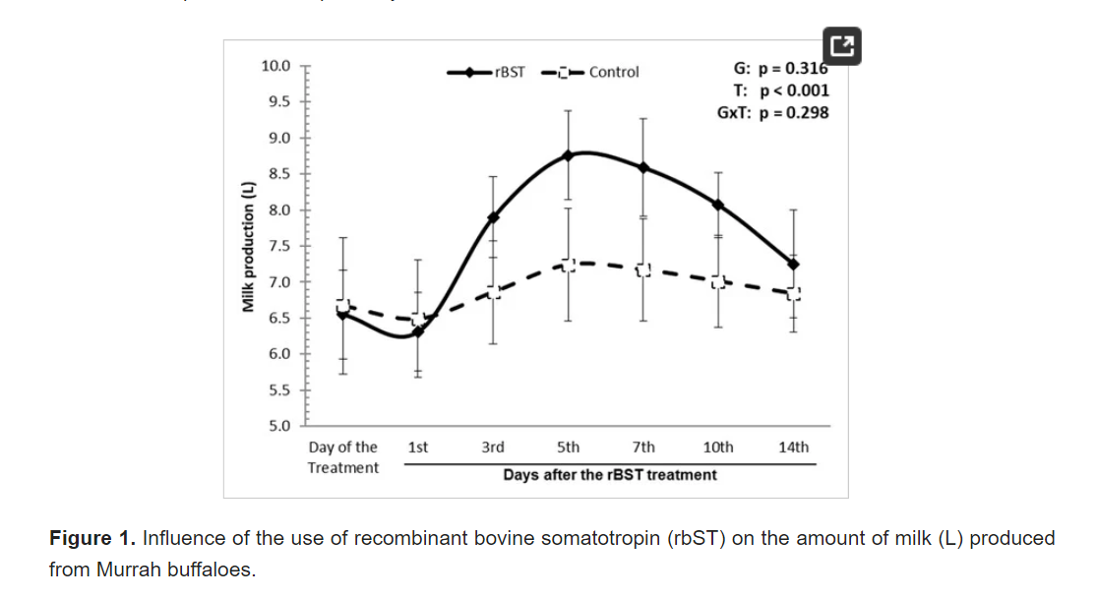
https://doi.org/10.3390/ani14040636

Slide 43
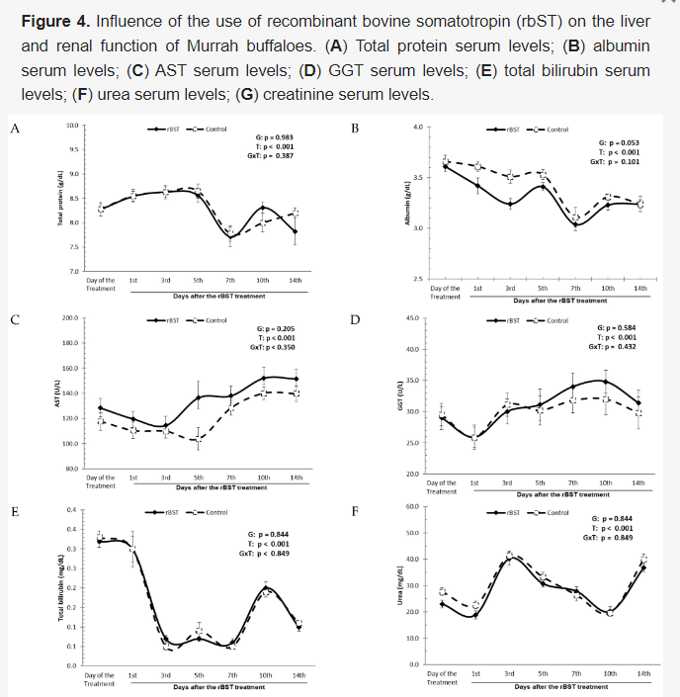
https://doi.org/10.3390/ani14040636

Slide 44
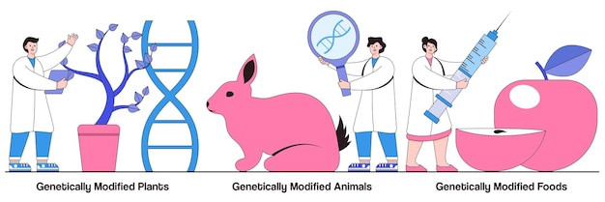
Genetically Engineered Plants and Animals in Industry

Slide 45
Engineering Plants for Industrial Applications
Insect Resistance: Genetically engineered plants exhibit resistance to insects through the incorporation of genes such as Bacillus thuringiensis (Bt), offering sustainable solutions in agriculture and reducing the need for chemical pesticides.
Enhanced Nutritional Capabilities: Genetic engineering has led to the enhancement of nutritional capabilities in crops, such as engineering vitamin A into rice and amino acids into legumes and cereals, addressing global food security challenges.

Slide 46

https://www.nature.com/articles/nbt1082

Slide 47
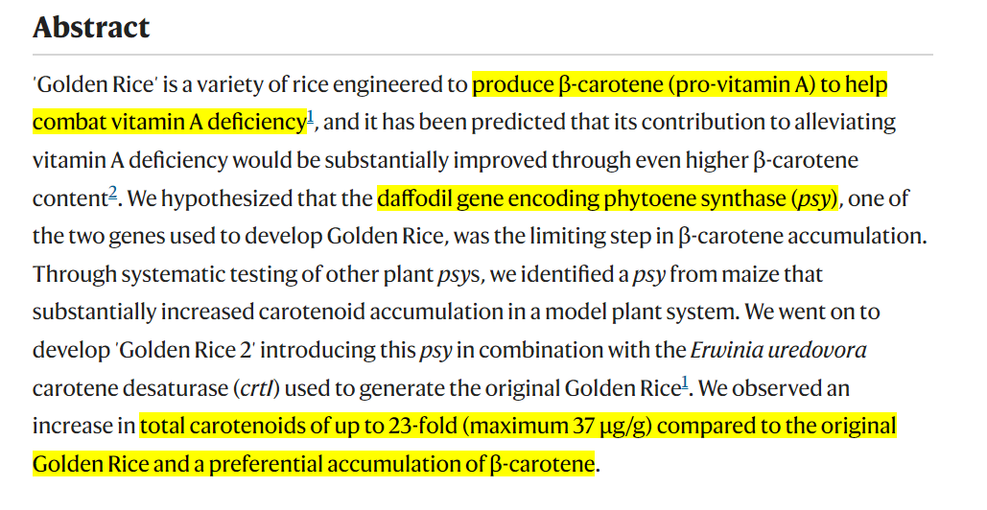
Ref: https://www.nature.com/articles/nbt1082

Slide 48
Transgenic Animals as Bioreactors
Pharming: Transgenic animals serve as bioreactors for the production of pharmaceuticals, offering cost-effective and exclusive methods for drug production, contributing to the development of value-added agricultural products.
Advantages of Transgenic Bioreactors: The use of transgenic animals as bioreactors provides advantages such as lower drug costs, faster manufacturing, and the production of drugs that may be unavailable through other methods.

Slide 49

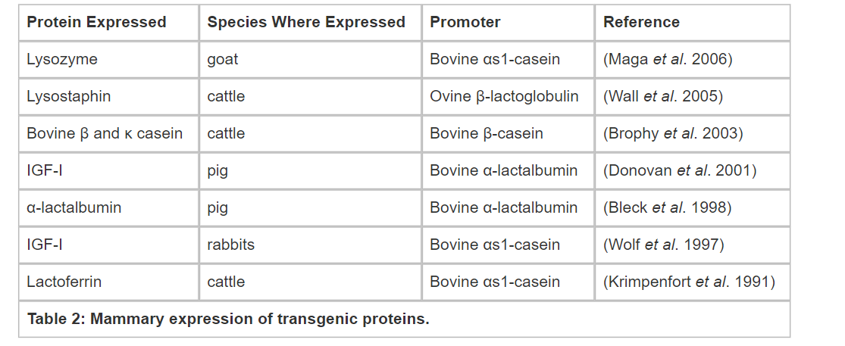
Ref: https://www.nature.com/scitable/knowledge/library/transgenic-animals-in-agriculture-105646080/

Slide 50
Conclusion
Genetic engineering is a powerful tool with the potential to revolutionize industries.
As research continues, we can expect even more innovative applications that benefit society.
Responsible development and ethical considerations are crucial for maximizing the positive impact of this technology.
Notes:
Genetic engineering offers a powerful toolkit for transforming industries. From efficient bioremediation to the creation of life-saving drugs, the applications of

Slide 51
REFERENCE
https://www.nbcnews.com/health/health-news/new-gene-editing-systems-are-more-precise-n814446
https://www.rxlist.com/follistim-drug.htm
https://atriainnovation.com/en/blog/biohydrometallurgy-the-recycling-of-the-future/
https://doi.org/10.1021%2Facsomega.3c07372
https://link.springer.com/referenceworkentry/10.1007/978-3-540-77587-4_201
https://europlas.com.vn/en-US/blog-1/how-different-types-of-bioplastics-are-produced
https://www.nature.com/articles/news.2011.191
https://doi.org/10.3390/ani14040636
https://www.nature.com/articles/nbt1082
https://www.nature.com/scitable/knowledge/library/transgenic-animals-in-agriculture-105646080/

